Slide 1
UKRDC - Technical Details

Slide 2
UKRDC History
The UKRDC went Live in its original form in January 2015
It validated and normalised the incoming “PV Feeds” before sending the data on to the newly developed PatientView2 and RADAR2 systems, conditional on the patient being recorded as participating in those systems.
Later on we added the processing of PROM/PAM/EQ5D surveys for display in PatientView, before turning our focus to the development of the full UKRDC feed.
This was where we started to have some issues with the platform we were developing on, partly because our requirements are very different from those of a single-site Electronic Patient Record.
We took most of the development in-house and increased the number of developers gradually from 2 to 6 and in Summer 2018 switched over to -

Slide 3
UKRDC Current Infrastructure
Incoming Data Validation – Python
Data Storage – Java
Database - PostgreSQL
EMPI – Java
Outgoing Data Formatting – Python
User Interface – Python / Javascript
Basically everything has changed, with the exception of -

Slide 4
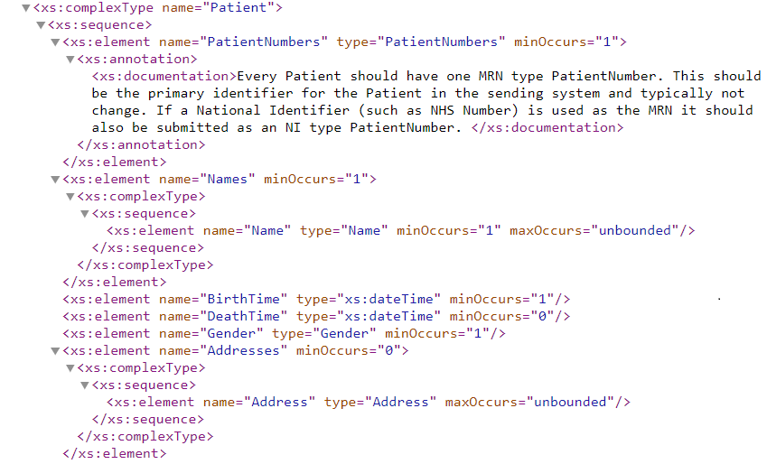
UKRDC – Schema

Slide 5
UKRDC – Schema – Why?
Pros:
Used Internally by our previous Platform.
Was already being used externally by PatientView, RADAR etc.
We looked at:
EDIFACT
HL7v2
HL7v3
CDA
OpenEHR
FHIR
Not ‘Finished’, Not ‘Suitable’, No NHS Digital Guidance, No supplier consensus.
We have also had similar difficulties with LOINC and SNOMED.

Slide 6
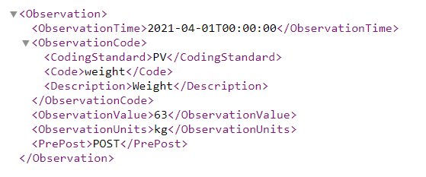
UKRDC - Database
XML – Observation Element
Database – Observation Table

Slide 7
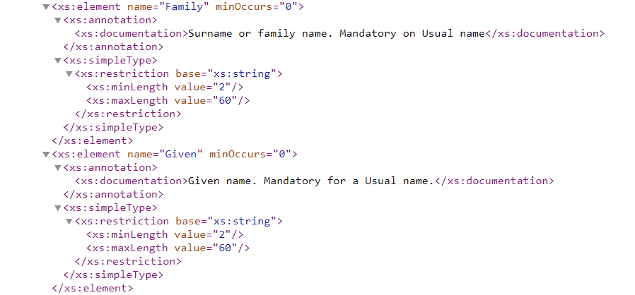

UKRDC – V5 Dataset
UKRR Item Description
UKRDC Schema
Data
Field ID | Format | Item Description | UKRDC (RDA) Mapping
IDN01 | C20 | Patient Surname | Patient/Names
IDN02 | C20 | Patient Forename | Patient/Names

Slide 8
UKRDC – Processing
Check it conforms to the schema, or basic sanity checks – reject if not.
For example:
  Are any Postcodes Valid?
  Are any Activity Dates (Test Results etc.) before the Patient’s DOB?
  Are any Dates far in the Future? 09/03/2082 etc.
Check that the data is reasonable – warn if not. This is similar to the checks done in the Quarterly Validation
For example:
  Is a Test Result within expected Ranges
  Does a Patient have HD Sessions but no HD Modality?

