Slide 1
Welcome to the September Q&A!
Trusts represented today include: North Bristol, Oxford, Liverpool, Exeter, Ayrshire, Cork, Derby, Imperial, Manchester, Lanarkshire

Slide 2
Conference Update:
UK RPG Conference 2023
Registration CLOSED
Hope to see you there ☺

Slide 3
Supply Problems
Basiliximab –
ESCALATE handling of supply problem with NHSBT/CRG
Novartis escalation process?
Not on SPS supply problems spreadsheet – handed over to RPG committee for escalation

Slide 4
Q&A Themes - Renal
Administration guide sodium bicarbonate polyfusor 1.26%
Tinzaparin dosing in GFR < 30ml/min
Roxadustat dosing – most seem to dose 70mg 3 x week irrespective of ESA req. (wt <100kg)
Poll Paper Px or Electronic (Cyclo/Ritux) – Paper 25 : Electronic 8
Highest dose of meropenem used GFR around 40ml/min
Follow RDD which allows up to 2g b.d. in GFR 25-50ml/min for some indications
Advise to watch for LFT rise in high doses
Experience of higher doses of eculizumab 1500mg instead of the usual 1200mg – Yes
Renal biopsy protocol – desmopressin dosing
Budesonide for IgA nephropathy – poster availability/local experience
Rituximab reactions – different brands tried or not
Anyone using Kitelock 4%

Slide 5
Q&A Themes - Renal
Poll Benzylpenicllin dosing RDD or SPC – RDD 12 : SPC 0 : Depends 1
Fondaparinux in GFR < 10ml/min for VTE prophylaxis
Consensus likely to be not to use in GFR < 10ml/min
Mesna use for oral cyclophosphamide
Any centres commissioned to give belimumab for lupus
Vasculitis guideline request for Avacopan
Lupus guideline request for voclosporin
Creatinine or CrCl/GFR for dosing Cyclophosphamide – EULAR
Methotrexate use/dosing in GFR < 30ml/min
Dimethyl fumarate in ESRF experience
Fondaprinux dosing in GFR < 20ml/min for ACS – RDD cautious
Lots of caution around this.
All centres on the call would still use LMWH
Single stat dose Fondaparinux has been suggested as an option in Manchester but not routine practice

Slide 6
Q&A Themes - Dialysis
Levetiracetam dosing in ESRF on HD
Entresto dosing – anything in the literature supporting use in ESRF/low clearance and HD
Daptomycin dosing >6mg/kg – yes – units use 10-12mg/kg 3 x week
Vitamin K preparations in calciphylaxis (K1, k2, k4?)
Phytomenadoine/menadiol/k4?
Small studies suggesting efficacy
Session on kidney research at RPG will cover some work looking at this
Thiosulphate – does anyone give at beginning – some literature suggests – All res. over last 1hr
Roxadustat stabilised patient starting HD – keep on Rox or switch to ESA
Deferasirox OR Desferrioxamine OR Deferiprone

Slide 7
Q&A Themes - Dialysis
Difelikafalin (DFK) guideline request
Used in 1 patient in Manchester – appeared to work well – calmed pruritis
In tariff so cost is a concern – out of existing budget – despite Blueteq form
Possibility of long term benefit after 6 month treatment – case report pending
Phosphate enema addition to dialysate
Eprex/Aranesp conversion
ADHD/ADD medication experience in ESRF/Dialysis – dexamfetamine/methylphenidate
Daptomycin – given in washback – yes during last 30 mins
Request self-care guidelines (patient self-dialyses in the unit)
Abx prophylaxis for PD patient having flexi-sigmoidoscopy
ISPD guidelines – Infection 2022
Not routinely covered in Oxford – given cefazolin 1g in high risk patients

Slide 8
Q&A Themes - Transplant
Anyone used remdesivir in GFR < 30ml/min (non-dialysis transplant patient)
Anyone given Sirolimus enterally
Sirolimus to ciclosporin – conversion guideline
Overlap or not?
Everolimus to tacrolimus – conversion guideline
Failing transplant wanting Roxadustat – covered by NICE TA
Poll: Latent TB – attempt prophylaxis pre-transplant 2 : prophylaxis post transplant 14
Basiliximab stock issues – campath availability to non user centres

Slide 9
Q&A Themes - Transplant
Modigraf sub-lingual use
Survey: Diabetes management in UK Renal Transplant Centres
Febuxostat with ciclopsorin – SPC says not recommended due to lack experience
Ciclosporin to tacrolimus – conversion guideline
Doravirine affecting tacrolimus levels
ATG and pregnancy – any experience
Tacrolimus and caspofungin – interaction or not

Slide 10
Updates
NICE TA for difelikefalin have gone to CRG for clarification of commissioning
Some queries around funding on whatsapp
Difelikefalin for treating pruritus in people having haemodialysis [ID3890 ]
In development [GID-TA10793]Expected publication date: 26 April 2023
TA out ?next week
Can be used for moderate-severe pruritis, not specified in NICE order of treatment.
Can have up to four times weekly in wash-back on dialysis
Need to use itching scale as per clinical trials.
Cambridge experience being used in ~17 pts across 4 units
Blueteq is coming but currently in block contract so trusts will need to absorb cost until contracts resolved.
MDT using WI-NRS quantifies pruritis
Process includes optimising biochemistry 1st (e.g. phosphate) and trialling traditional agents.
DFK then trailled for up to 12/52 before review
Voclosporin with immunosuppressives for treating lupus nephritis [ID3962]
Blueteq has gone live,
Cambridge have a regional MDT (inc pharmacists to approve avacopan/voclosporin).

Slide 11
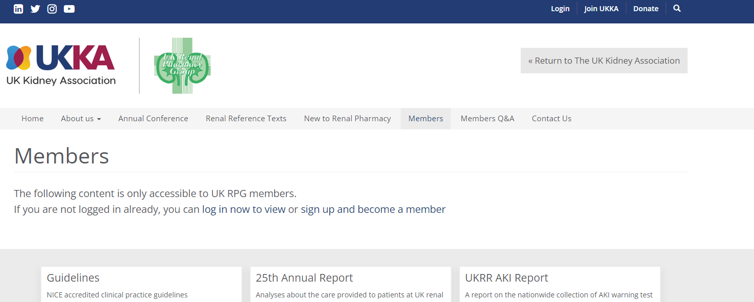
Updates
UKKA membership - Please can all members log into the website to check your renewal status
A number of Whatsapp members have lapsed membership and we are working to ensure all active Q&A members have a current membership
Check your contact emails +/- spam boxes as some of the renewals appear to be going there

Slide 12
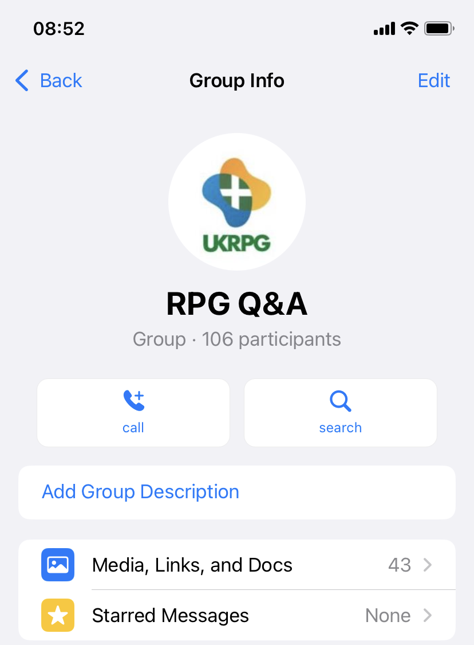
Q&A Themes – Guideline sharing
Teams page kindly set up to help with guideline sharing but issues around universal access
Need to ensure access is managed? (note out of date UKKA membership within whatsapp)
Version control issues?
Whatsapp is searchable for previous queries/guidelines
Discussion within group:
Teams platform is problematic as many units can’t access
May be helpful to list what each unit does/key contacts/guidelines available
rather than a database of specific guidelines
Preference for guidelines to remain within Q&A then original authors can
ensure version control/update with any relevant commentary
Q&A allows signposting to relevant units
Feedback to exec committee for plan

Slide 13
Updates
ERA have negotiated a deal with UKKA that all UKKA members will become full members of ERA – paid for by UKKA 🙂
Email will be coming out soon to confirm permission for your details to be shared with ERA

Slide 14
Conference Update:
UK RPG Conference 2023
Registration CLOSED
Hope to see you there ☺

Slide 15
September Q&A - Close
Thank you for attending!
Next Q&A: Wednesday 11th October
Keep in touch throughout the month on WhatsApp Q&A Group
>100 participants throughout UK and Ireland
Useful real time forum for clinical Q’s
Please consider joining!

