Slide 1
Welcome to the June Q&A!
Presenting an overview OF UKKW themes:
RSTP, Hypertension, Health literacy & CKD and EMPA Kidney update
Trusts represented today include:

Slide 2
UKKW themes: RSTP
Launched in June by Smeeta Sinha and Ahmad Saleem
Toolkits launched on NHS Futures
Need to register for NHS futures then request to join the regional/RSTP workspaces
UKKA update: Kathrine Parker is new academic vice president for UKKA
Clinical (non-medical) VP post open for applications
Focus for next 12/12 wil be education.
Renal pharmacists are encouraged to apply/partake

Slide 3
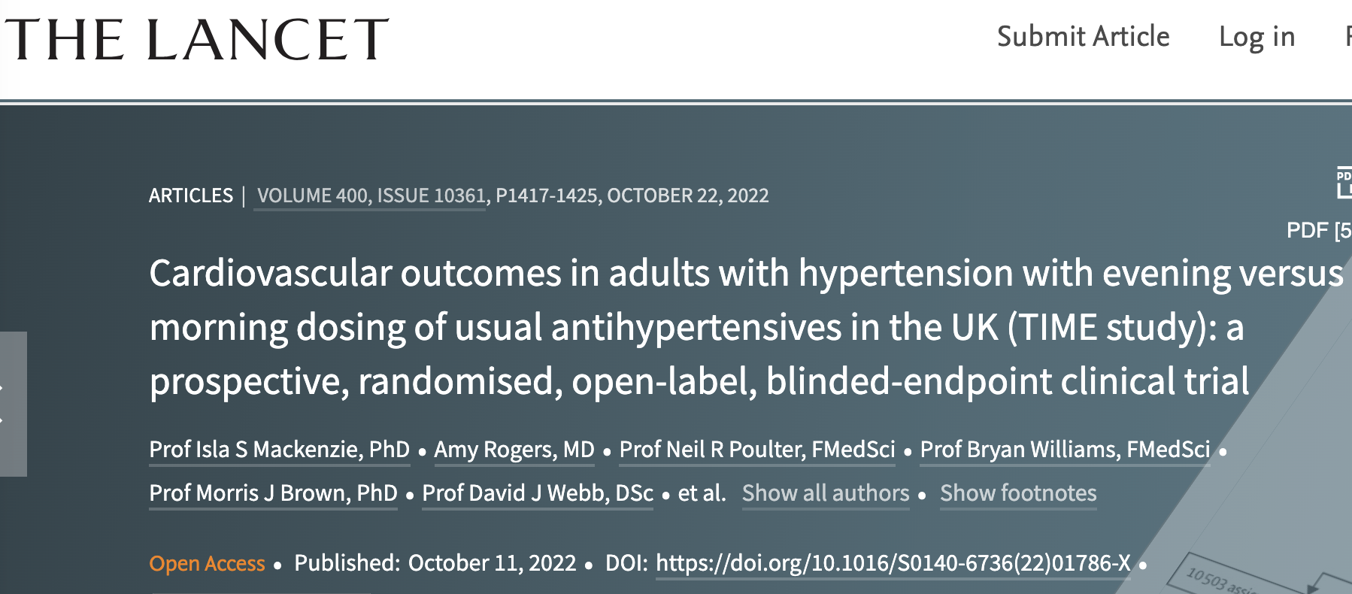
UKKW themes: Hypertension
Cardiologist/pharmacologist from Cambridge
British & Irish Hypertension Society (BIHS) guidelines recommending longer acting agents (e.g. amlodipine) and gradual BP reductions Vs rapid reduction (increases risk)
TIME study (Lancet) looking at timing of antihypertensives (PM Vs AM)
Question re Spanish study several years ago in contrast to this data. Previous literature suggested night time dosing improves CV outcomes.
TIME study suggests not

Slide 4
UKKW themes: Hypertension
UKKA working group looking at guidelines for hypertension in dialysis

Slide 5
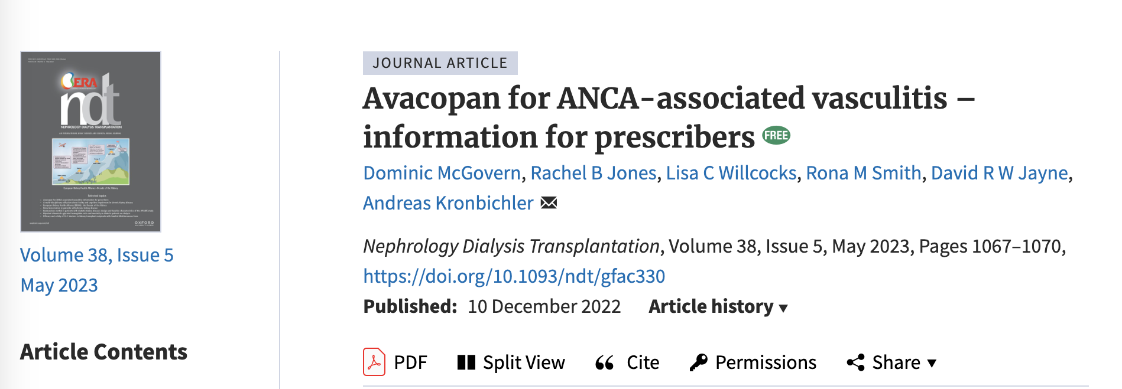
UKKW themes: New treatments in ANCA vasculitis
Avacopan not yet studied without steroids
Wide variability in steroid reduction plans across centres
Transaminitis seen in some observational data (not common)
Discussion around using avacopan >1yr – not yet studied
Paper in NDT

Slide 6
UKKW themes: New treatments in ANCA vasculitis
Cambridge using in avacopan in ~ 10 pts. All are having concurrent steroids
No standard steroid reduction
Fairly rapid reduction in all patients not based on disease severity

Slide 7
UKKW themes: Health literacy and CKD
Frequent theme in communicating with patients
~23% of CKD patients have limited health literacy
Differences between equality and equity
Treating all the same Vs giving additional tools to those who need it to reach the same outcome
Dominic M Taylor and others, Health literacy and patient outcomes in chronic kidney disease: a systematic review, Nephrology Dialysis Transplantation, Volume 33, Issue 9, September 2018, Pages 1545–1558
Morony S, Flynn M, McCaffery KJ, Jansen J, Webster AC. Readability of Written Materials for CKD Patients: A Systematic Review. Am J Kidney Dis. 2015 Jun;65(6):842-50.
40-80% of information provided during consultations is forgotten
Health literacy was considered a theme within RSTP (transplant in particular)

Slide 8
UKKW themes: EMPA kidney update
EMPA considered GFR down to 20 and lower levels of albuminuria
Less CV death and less kidney disease progression in EMPA group
Primary outcome was kidney disease progression, somewhat underpowered to pull out CV outcomes but still strong data
Less events even in those without diabetes
Chronic (total) slope on ml/min/1.73m² per year becoming more frequent in research
Generally required by FDA
Chronic slope decline shows benefits at low levels of albuminuria
Ketoacidosis remains concern amongst SGLT2 use. Numbers v low in EMPA group

Slide 9
UKKW themes: EMPA kidney update
SMART-C; Useful study to demonstrate v low risks of ketoacidosis and AKI
EMPA kidney (lesser extent but also with dapa) also included patients with glomerular disease to add confidence in treating these groups
UKKA revised guidance on SGLT2i’s

Slide 10
UKKA SGLT2 inhibitor CKD guideline:
2023 UPDATE
To reduce risk of kidney disease and cardiovascular outcomes |  | Urinary albumin-to-creatinine ratio (mg/mmol)
 |  | <25 | ≥25
eGFR (mL/min/1.73m²) | ≥60 |  | Recommended
 | ≥45 <60 | Suggested (in type 2 diabetes) | Recommended
 | ≥20 <45 | Recommended (For diabetes=1A) (For no diabetes=1B†) | Recommended (All =1A)
 | <20 | Suggested | Suggested
 | Dialysis | Not recommended | Not recommended
Note: People with type 1 diabetes, polycystic kidney disease, or kidney transplant excluded from the definitive trials
† Safety profile better in patients without diabetes vs without, and can be used to slow rate of decline in eGFR

Slide 11
Renal Review magazine –KP Manchester
Ongoing updates through renal review newsletter
Free email sign up at www.renalreview.com
Isaac, Olivia and Natasha doing research around pharmacists attending dialysis MDT’s – survey to follow in Q&A

Slide 12
Supply Problems
Dailiport 5mg issues (other strengths available)
Sodium thiosulphate (?resolving)
Oxycodone Liquid – seems resolved

Slide 13
Q&A Themes - Renal
? Sevelamer reformulation as liquid
Roxadustat dosing advice
RSTP toolkits on NHS Futures page
Vedolizumab at GFR 34 (not answered)
Renal pharmacy workforce calculator – deadline extended
Enoxaparin levels in dialysis/non-dialysis
Steroid wean protocols for vasculitis using avacopan

Slide 14
Q&A Themes - Dialysis
IP plus PO fluconazole for peritonitis
Acetazolamide in HD
Levetiracetam as CSCI at ESRF (Not RRT)
Apixaban in RRT - ? Levels/LMWH interaction advice
Enoxaparin in ESRF

Slide 15
Q&A Themes - Transplant
Egg donation on MMF
Myfortic doses >720mg BD
I?S via shared care with primary care
Imlifidase – progressing. Dane/Dawn/Sara working on some pt and pharmacy info

Slide 16
Updates
NICE TA’s for difelikefalin have gone to CRG for clarification of commissioning
Difelikefalin for treating pruritus in people having haemodialysis [ID3890 ]
In development [GID-TA10793]Expected publication date: 26 April 2023
TA out ?next week
Can be used for moderate-severe pruritis, not specified in NICE order of treatment.
Can have up to four times weekly in wash-back on dialysis
Need to use itching scale as per clinical trials.
Voclosporin with immunosuppressives for treating lupus nephritis [ID3962]
In development [GID-TA10878]Expected publication date: 26 April 2023
?monitoring required
Blueteq

Slide 17
Conference Update:
UK RPG Conference 2023
Registration NOW OPEN

Slide 18
May Q&A - Close
Thank you for attending!
Next Q&A: Tuesday 11th July
Keep in touch throughout the month on WhatsApp Q&A Group
90 participants throughout UK and Ireland
Useful real time forum for clinical Q’s
Please consider joining!

