Slide 1
Welcome to the August Q&A!
Trusts represented today include: North Bristol, Royal Free, Cornwall, Cork, Northampton, Imperial, Leicester

Slide 2
Conference Update:
UK RPG Conference 2023
Registration NOW OPEN
Abstract submission deadline extended – 25th Aug

Slide 3
Supply Problems
Adoport 2mg - resolved

Slide 4
Q&A Themes - Renal
Apixaban in nephrotic syndrome
MPA/sirolimus back onto HCD list
Training plans for rotational pharmacists
Document sharing – see later slide
Remdesivir in Cv19
Cyclophosphamide in FSGS
Ovarian protection with cyclophosphamide
Biktarvy in CKD?
Cinacalcet down NGT
Maintenance rituximab with in patient with shingles?
Voclosporin live on blueteq
Pruritis guideline in CKD
Eprex switches?
Albumin in PEX
Contrast allergy

Slide 5
Q&A Themes - Dialysis
Posiflush for CVCs?
Prucalopride in HD
Guidelines for peritonitis
Methenamine in HD
Hair loss with circuit anticoagulation
Apixaban with RRT
LMWH treatment dose reduction in RRT
Cefazolin in HD
Restless leg treatments
Anyone using clearguard line caps?

Slide 6
Q&A Themes - Dialysis
Return of alteplase 2mg supplies – units now seeing resilience in supply
Amikacin in HD
Ametop for needling
IVIG administration during HD
Sorafenib in HD?
WDA and dialysis units
Vit D replacement/treatment on HD
Mupirocin around exit sites
Teriparetide in HD
Thiosulphate/Etelcalcetide concurrently
High dose pip/taz in HDF
MHRA alert for calcium gluconate
Cipro dosing in HD
IV Ketamine for pain

Slide 7
Q&A Themes - Transplant
Tac with antiretrovirals
?Issues with basiliximab & ^ rejection
Tac interactions in de novo Tx
Bisphosphonate use in Tx
Tac dosing alongside ATG
Ustekinumab in Tx?
Research options for Kidney Research UK
IVIG in BK nephropathy

Slide 8
Updates
NICE TA for difelikefalin have gone to CRG for clarification of commissioning
Some queries around funding on whatsapp
Difelikefalin for treating pruritus in people having haemodialysis [ID3890 ]
In development [GID-TA10793]Expected publication date: 26 April 2023
TA out ?next week
Can be used for moderate-severe pruritis, not specified in NICE order of treatment.
Can have up to four times weekly in wash-back on dialysis
Need to use itching scale as per clinical trials.
Cambridge experience being used in ~17 pts across 4 units
Blueteq is coming but currently in block contract so trusts will need to absorb cost until contracts resolved.
MDT using WI-NRS quantifies pruritis
Process includes optimising biochemistry 1st (e.g. phosphate) and trialling traditional agents.
DFK then trailled for up to 12/52 before review
Voclosporin with immunosuppressives for treating lupus nephritis [ID3962]
Blueteq has gone live,
Cambridge have a regional MDT (inc pharmacists to approve avacopan/voclosporin).

Slide 9
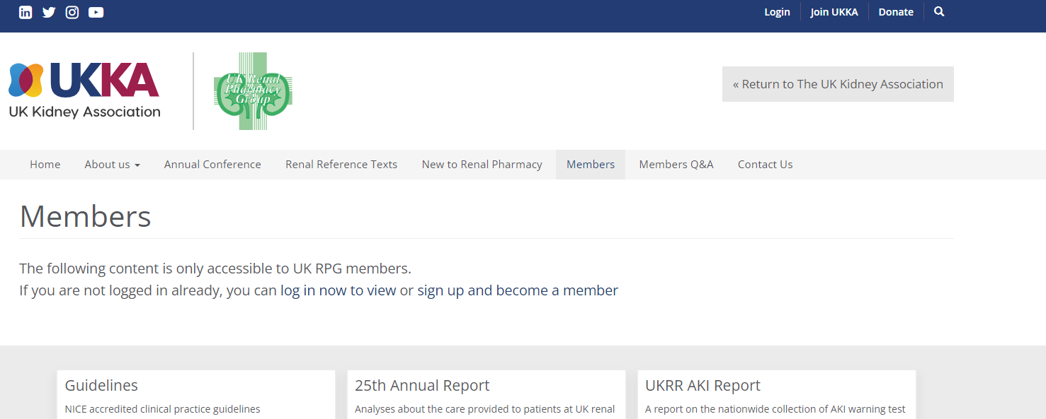
Updates
UKKA membership - Please can all members log into the website to check your renewal status
A number of Whatsapp members have lapsed membership and we are working to ensure all active Q&A members have a current membership
Check your contact emails +/- spam boxes as some of the renewals appear to be going there

Slide 10
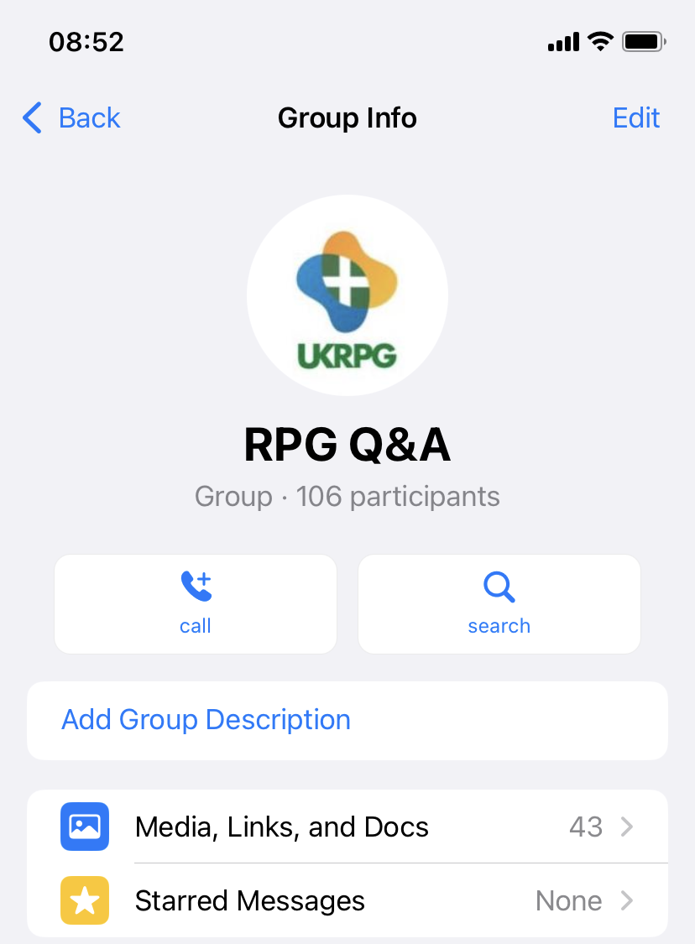
Q&A Themes – Guideline sharing
Teams page kindly set up to help with guideline sharing but issues around universal access
Need to ensure access is managed? (note out of date UKKA membership within whatsapp)
Version control issues?
Whatsapp is searchable for previous queries/guidelines
Discussion within group:
Teams platform is problematic as many units can’t access
May be helpful to list what each unit does/key contacts/guidelines available
rather than a database of specific guidelines
Preference for guidelines to remain within Q&A then original authors can
ensure version control/update with any relevant commentary
Q&A allows signposting to relevant units
Feedback to exec committee for plan

Slide 11
Updates
ERA have negotiated a deal with UKKA that all UKKA members will become full members of ERA – paid for by UKKA 🙂
Email will be coming out soon to confirm permission for your details to be shared with ERA

Slide 12
New Q
Qu from Bristol – any units close to implementing imlifidase?
No-one online appears close. May be Leeds/Bristol/London Kidney Network will implement soon ish.

Slide 13
New Q
Dapradustat withdrawn in UK, lack of evidence/cost effectiveness
Roxadustat remain only option in UK, cant be initiated in dialysis
Mixed uptake, Bristol using in @10-12 pts, NB interaction with statins

Slide 14
Conference Update:
UK RPG Conference 2023
Registration NOW OPEN
Abstract submission deadline extended – 25th Aug

Slide 15
August Q&A - Close
Thank you for attending!
Next Q&A: Tuesday 12th September
Keep in touch throughout the month on WhatsApp Q&A Group
>100 participants throughout UK and Ireland
Useful real time forum for clinical Q’s
Please consider joining!

