Slide 1
Laboratory AKI results: Audit and research outputs and the data portal
Shalini Santhakumaran
In relation to this presentation, I declare that there are no conflicts of interest

Slide 2
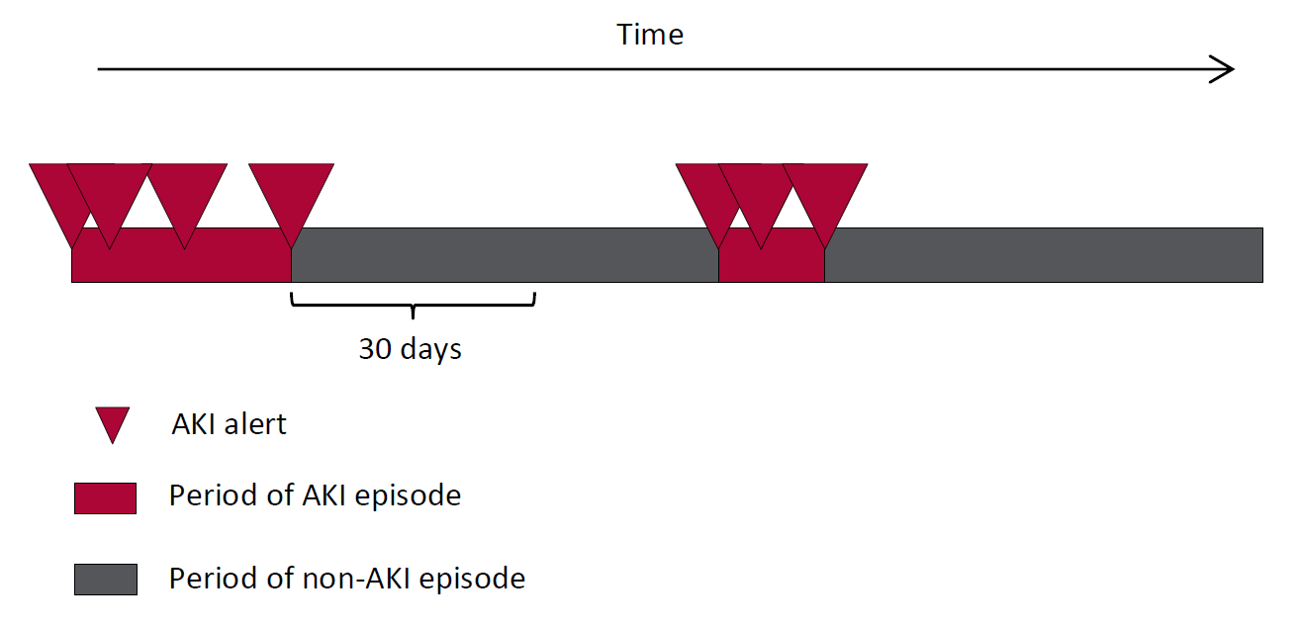
Defining AKI episodes
The UKRR collates the AKI alerts (stages 1, 2 and 3 in increasing order of severity) into a single Master Patient Index (MPI), which records each adult or child in England who has had an AKI alert.
As a patient can have multiple creatinine tests, and each one can trigger an alert, we consider instead AKI episodes.
Alerts within 30 days of the last alert are combined in the same episode.
Episodes can last a maximum of 90 days – beyond this is considered chronic kidney failure as defined by KDIGO.

Slide 3
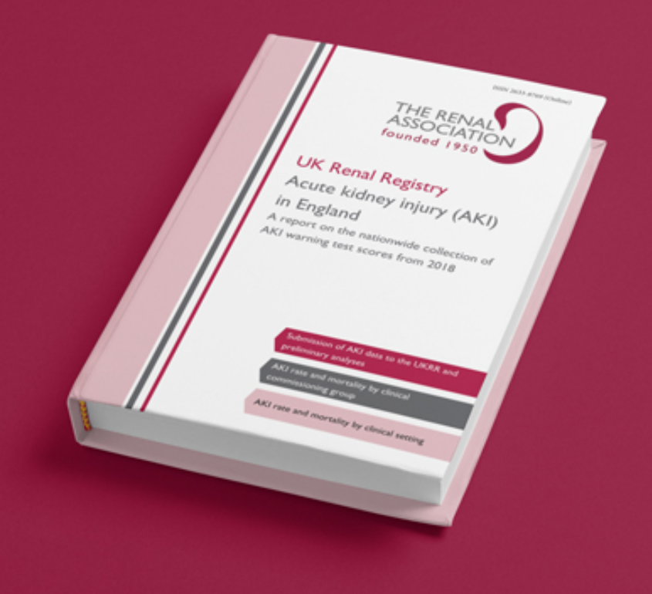
AKI national report
In July 2020 the UKRR published a summary report of AKI alerts in 2018, linked to HES.
Key findings :
Unadjusted rate of AKI in 2018 was 12,300 per million population
71% of people with an AKI episode had a hospital stay
Median length of stay was 12 days in hospital
18% of people with an AKI episode died within 30 days of the first alert. This increased with peak AKI stage – 13% for stage 1, 29% for stage 2 and 33% for stage 3.
Mortality was higher in those from lower socio-economic background and in winter.

Slide 4
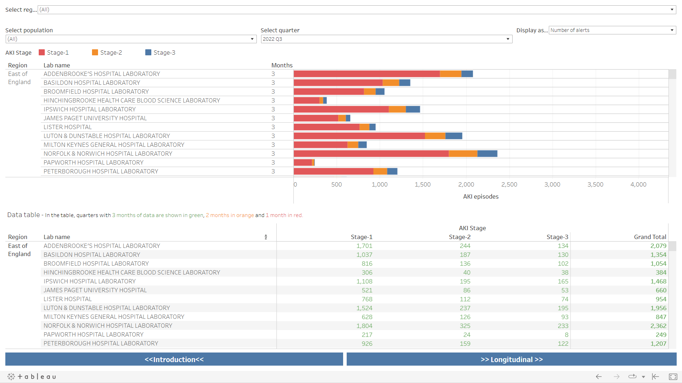
AKI data portal
The UKRR has always produced quarterly information on the AKI data by laboratory and commissioning body (previously Clinical Commissioning Group, now Integrated Care Board)
In December 2021 we introduced the AKI data portal to report this information
Laboratory data portal
In Q3 2022:
Over 150,000 AKI episodes (98% in adults)
78% stage 1
13% stage 2
9% stage 3
80% of laboratories submitted data for all 3 months

Slide 6
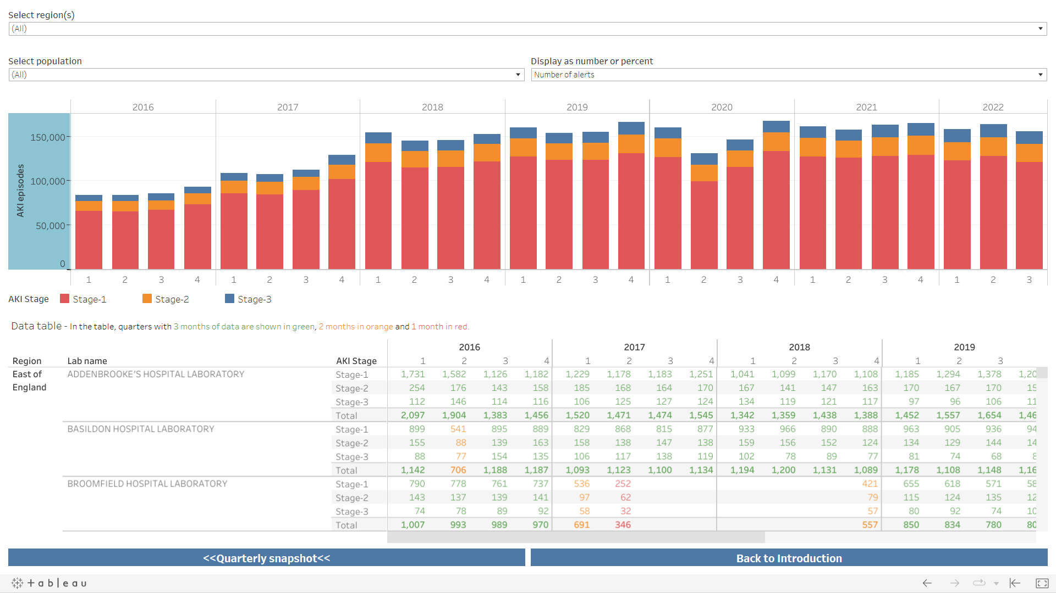

Slide 7
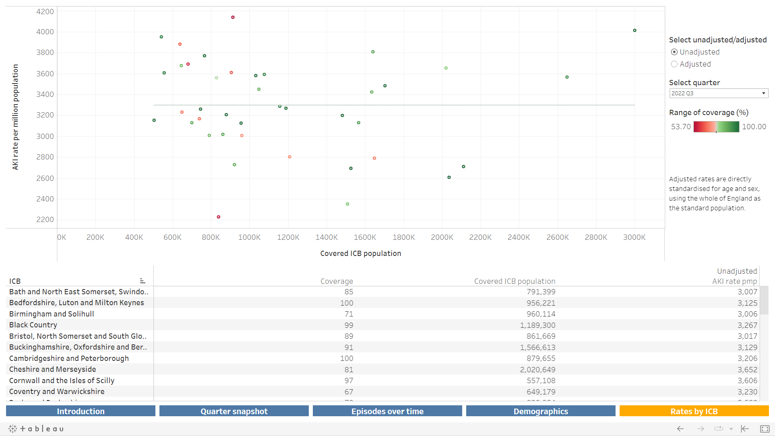
AKI data portal
The UKRR has always produced quarterly information on the AKI data by laboratory and commissioning body (previously Clinical Commissioning group, now Integrated Care Board)
In December 2021 we introduced the AKI data portal to report this information
ICB data portal
In Q3 2022:
Unadjusted rate of AKI in Q3 2022 was 3,297 per million population
Range from 2,227 to 4,139 across ICBs
3 in 4 ICBs had at least 70% population coverage based on the contributing laboratories

Slide 8
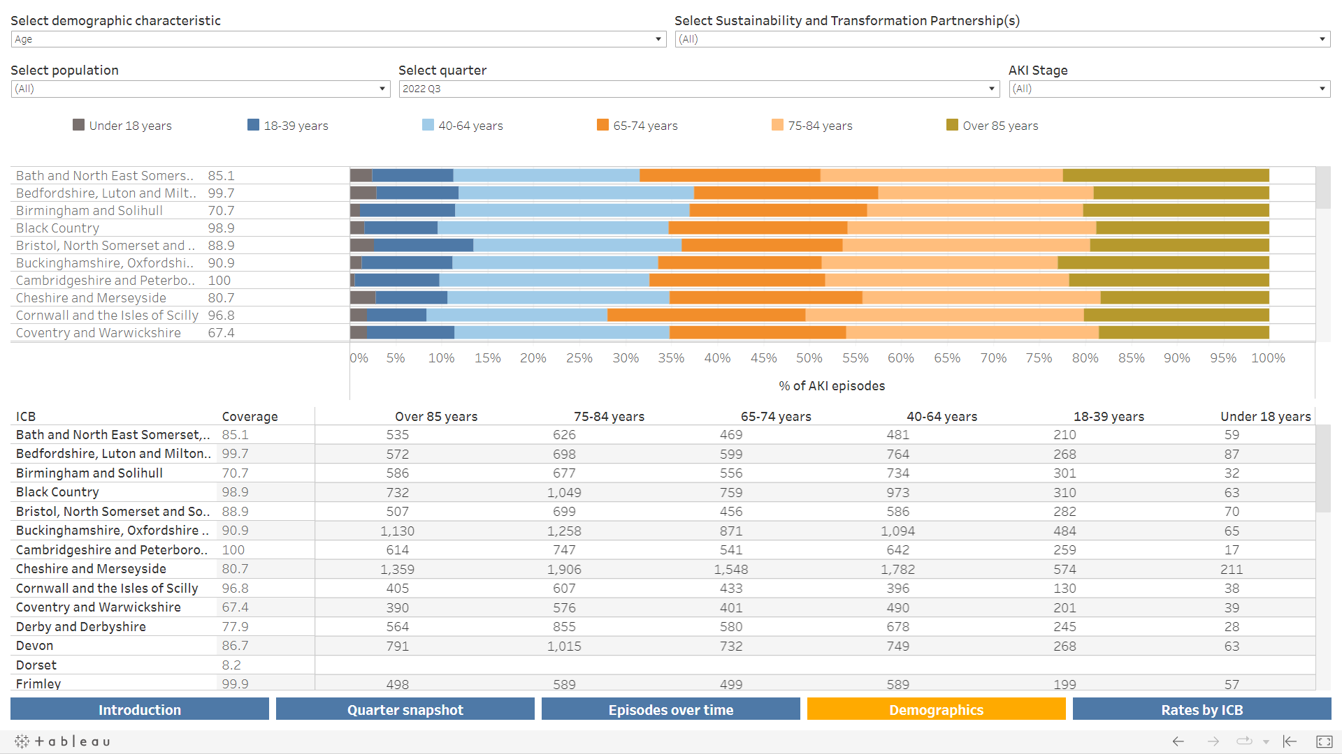

Slide 10
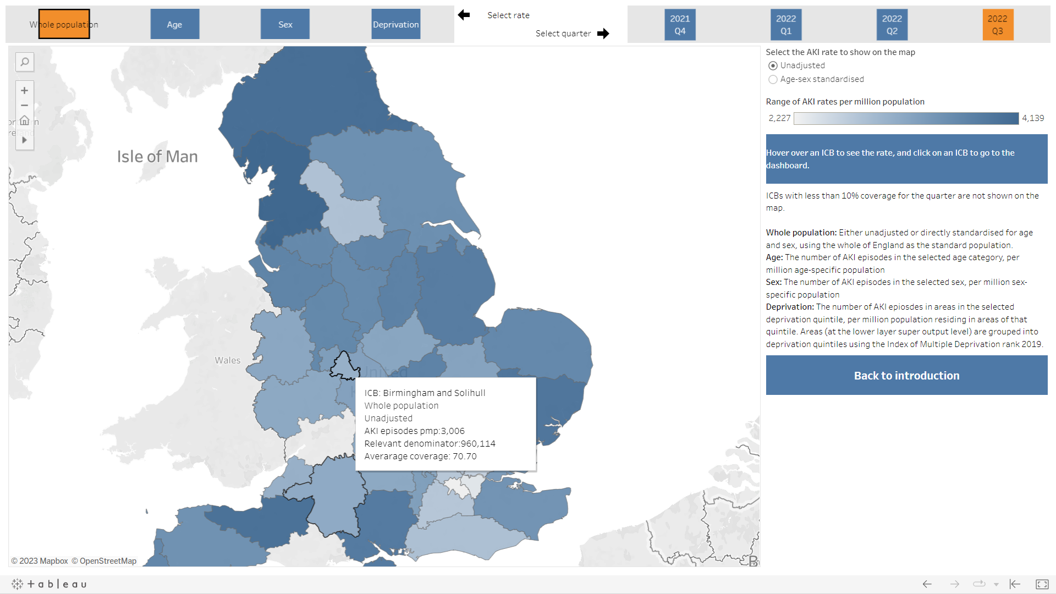

Slide 11
Seasonal variation in AKI incidence
AKI across clinical specialties
Research using AKI data
Rates of AKI in children
Validation of N17 coding in HES

Slide 12
Variation in AKI with temperature
Seasonal variation in AKI incidence
AKI across clinical specialties
Research using AKI data
RECOVERY trial for COVID-19 therapies
Validation of the AKI algorithm
Rates of AKI in children
Validation of N17 coding in HES
GIRFT-led AKI reserach

Slide 13
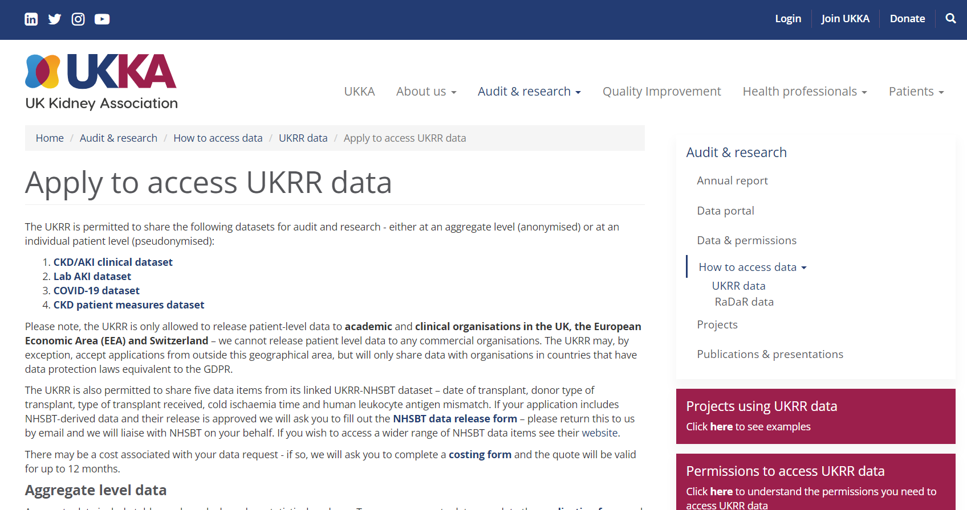
Variation in AKI with temperature
Seasonal variation in AKI incidence
AKI across clinical specialties
Research using AKI data
RECOVERY trial for COVID-19 therapies
Validation of the AKI algorithm
Rates of AKI in children
https://ukkidney.org/audit-research/how-access-data
Validation of N17 coding in HES
GIRFT-led AKI reserach

Slide 14
Thank you for listening

