Slide 1
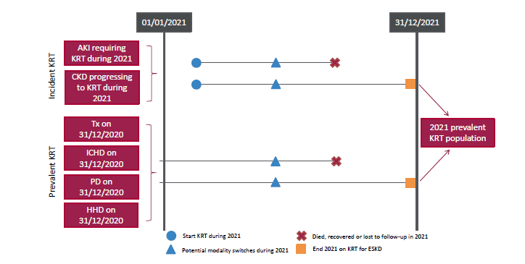
UK Renal Registry 25th Annual Report
Data to 31/12/2021
Figure 3.1 Pathways adult patients could follow to be included in the UK 2021 prevalent KRT population
Note that patients receiving dialysis for acute kidney injury (AKI) are only included in this chapter if they had a timeline or KRT
modality code for chronic KRT at the end of 2021 or if they had been on KRT for ≥90 days and were on KRT at the end of 2021.
CKD – chronic kidney disease; Tx – transplant

Slide 2
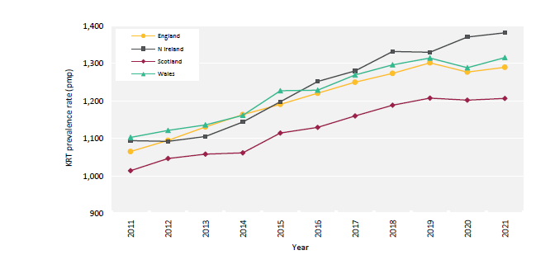
UK Renal Registry 25th Annual Report
Data to 31/12/2021
Figure 3.2 Adult KRT prevalence rates by country between 2011 and 2021
^{pmp – per million population}

Slide 3
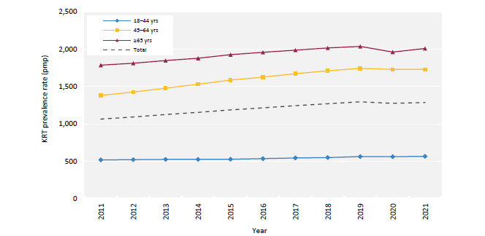
UK Renal Registry 25th Annual Report
Data to 31/12/2021
Figure 3.3 Adult KRT prevalence rates by age group between 2011 and 2021
^{pmp – per million population}

Slide 4
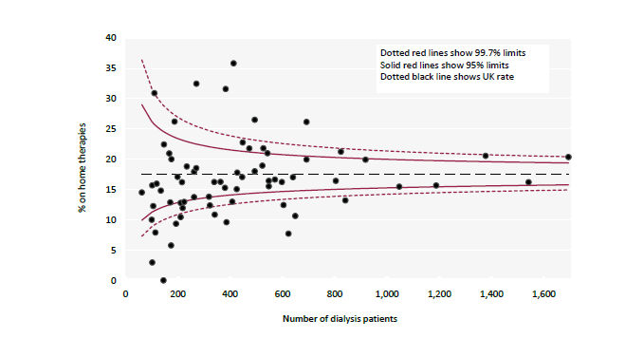
UK Renal Registry 25th Annual Report
Data to 31/12/2021
Figure 3.4 Percentage of adult patients prevalent to dialysis on 31/12/2021 on home therapies (PD and HHD) by centre

Slide 5
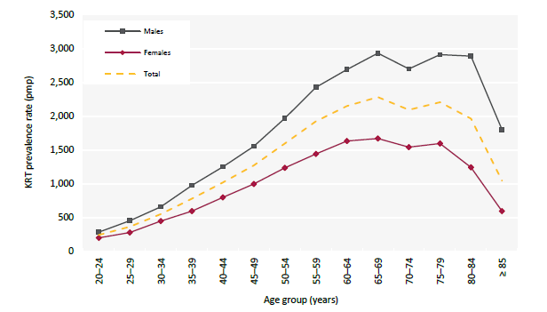
UK Renal Registry 25th Annual Report
Data to 31/12/2021
Figure 3.5 Prevalence rates for adult patients on KRT on 31/12/2021 by age group and sex
pmp – per million population

Slide 6
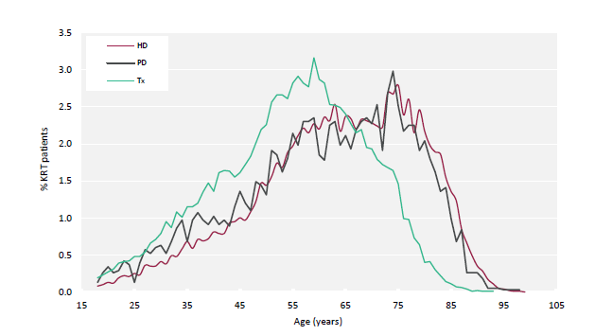
UK Renal Registry 25th Annual Report
Data to 31/12/2021
Figure 3.6 Age profile of adult patients prevalent to KRT on 31/12/2021 by KRT modality

Slide 7
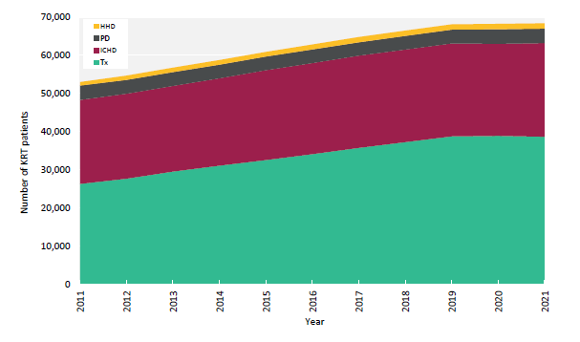
UK Renal Registry 25th Annual Report
Data to 31/12/2021
Figure 3.7 Growth in numbers of prevalent adult KRT patients by treatment modality between 2011 and 2021

Slide 8
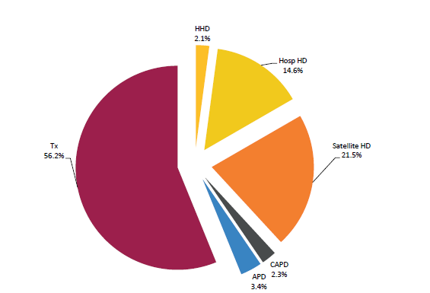
UK Renal Registry 25th Annual Report
Data to 31/12/2021
Figure 3.8 Detailed treatment modality of adult patients prevalent to KRT on 31/12/2021
No Scottish centres were included because data on satellite HD were not available.
APD – automated PD; CAPD – continuous ambulatory PD.

Slide 9
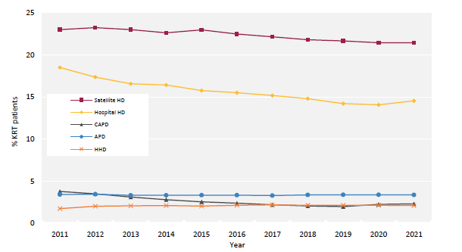
UK Renal Registry 25th Annual Report
Data to 31/12/2021
Figure 3.9 Detailed dialysis modality changes in prevalent adult KRT patients between 2011 and 2021
No Scottish centres were included because data on satellite HD were not available.
The denominator includes patients with a Tx.
APD – automated PD; CAPD – continuous ambulatory PD.

Slide 10
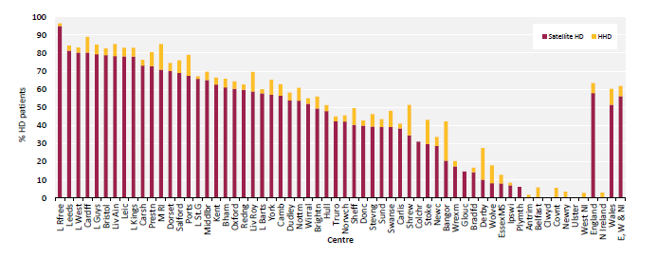
UK Renal Registry 25th Annual Report
Data to 31/12/2021
Figure 3.10 Adult patients prevalent to HD on 31/12/2021 treated with satellite HD or HHD by centre
There were no satellite units in Northern Ireland and Scottish centres were excluded because data on satellite HD were not available.

Slide 11
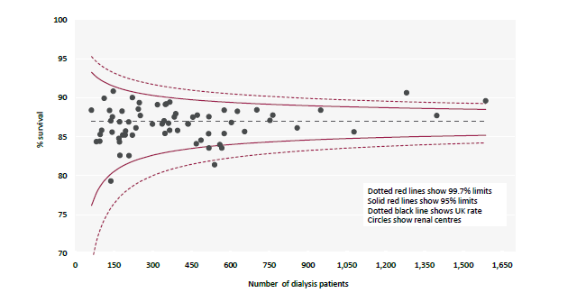
UK Renal Registry 25th Annual Report
Data to 31/12/2021
Figure 3.11 1 year survival (adjusted to age 60 years) of adult patients prevalent to dialysis on 31/12/2020 by centre

Slide 12
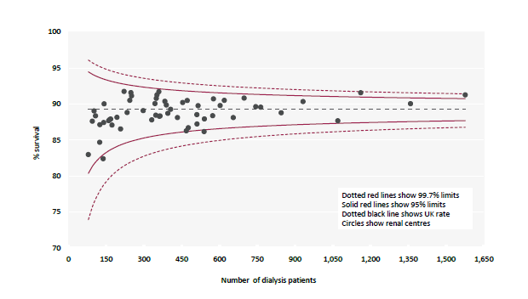
UK Renal Registry 25th Annual Report
Data to 31/12/2021
Figure 3.12 1 year survival (adjusted to 60 years, male and median comorbidity score) of adult patients prevalent to dialysis on 31/12/2020 by centre

Slide 13
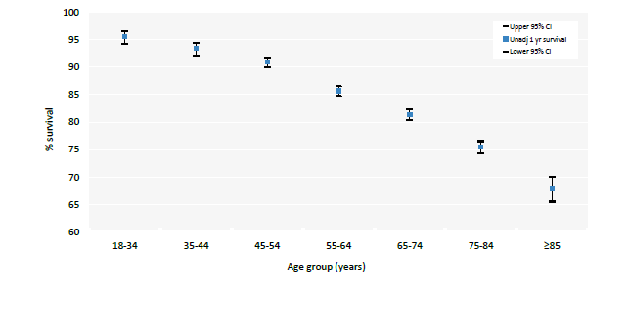
UK Renal Registry 25th Annual Report
Data to 31/12/2021
Figure 3.13 1 year survival (unadjusted) of adult patients prevalent to dialysis on 31/12/2020 by age group
^{CI – confidence interval}

Slide 14
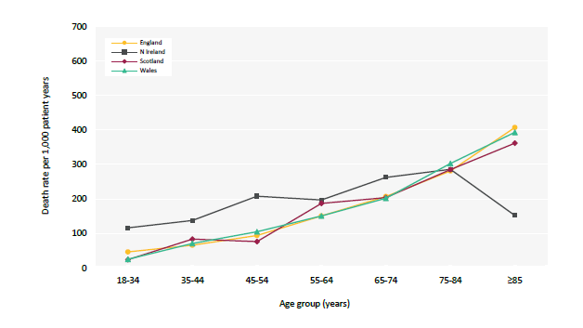
UK Renal Registry 25th Annual Report
Data to 31/12/2021
Figure 3.14 1 year death rate per 1,000 patient years for adult patients prevalent to dialysis on 31/12/2020 by country and age group

Slide 15
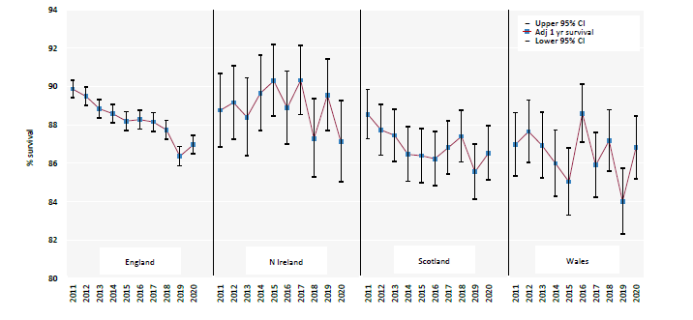
UK Renal Registry 25th Annual Report
Data to 31/12/2021
Figure 3.15 1 year survival (adjusted to age 60 years) for prevalent adult dialysis patients by country between 2011 and 2020
^{CI – confidence interval}

Slide 16
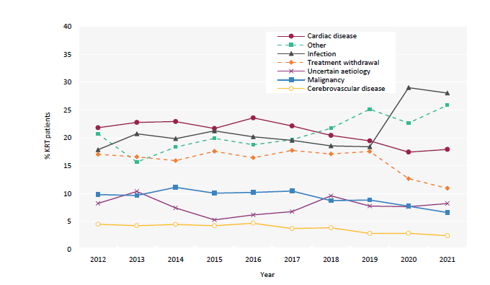
UK Renal Registry 25th Annual Report
Data to 31/12/2021
Figure 3.16 Cause of death between 2012 and 2021 for adult patients prevalent to KRT at the beginning of the year

