Slide 1
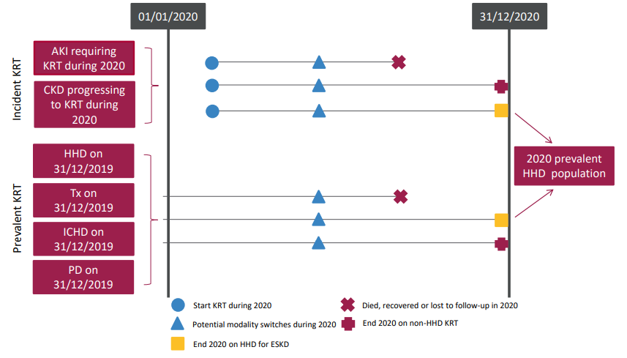
UK Renal Registry 24th Annual Report
Data to 31/12/2020
Figure 7.1 Pathways adult patients could follow to be included in the UK 2020 prevalent HHD population
Note that patients receiving dialysis for acute kidney injury (AKI) are only included in this chapter if they had a timeline or KRT modality code for chronic HHD at the end of 2020 or if they had been on KRT for ≥90 days and were on HHD at the end of 2020
^{CKD – chronic kidney disease}

Slide 2
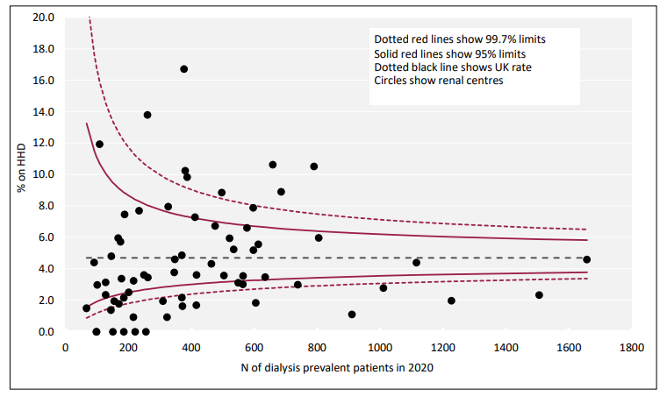
UK Renal Registry 24th Annual Report
Data to 31/12/2020
Figure 7.2 Percentage of adult patients prevalent to dialysis on 31/12/2020 who were on HHD by centre

Slide 3
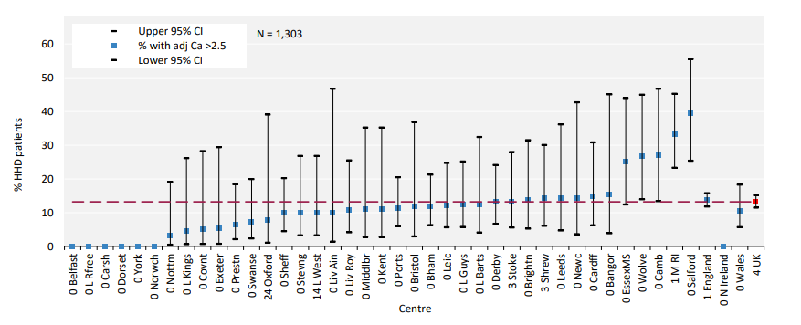
UK Renal Registry 24th Annual Report
Data to 31/12/2020
Figure 7.3 Percentage of adult patients prevalent to HHD on 31/12/2020 with adjusted calcium (Ca) above the target range (>2.5 mmol/L) by centre
^{CI – confidence interval}

Slide 4
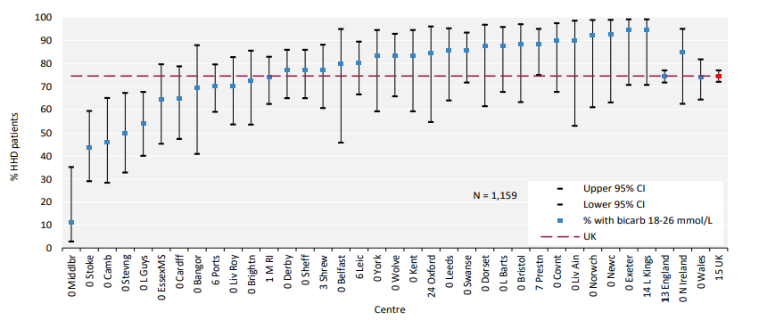
UK Renal Registry 24th Annual Report
Data to 31/12/2020
Figure 7.4 Percentage of adult patients prevalent to HHD on 31/12/2020 with pre-dialysis bicarbonate (bicarb) within the target range (18–26 mmol/L) by centre
^{CI – confidence interval}

Slide 5
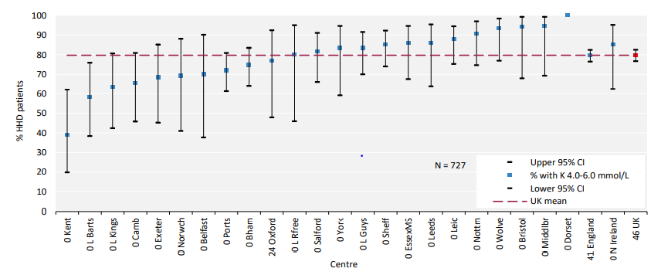
UK Renal Registry 24th Annual Report
Data to 31/12/2020
Figure 7.5 Percentage of adult patients prevalent to HHD on 31/12/2020 with pre-dialysis potassium (K) within the target range (4.0–6.0 mmol/L) by centre
^{CI – confidence interval}

Slide 6
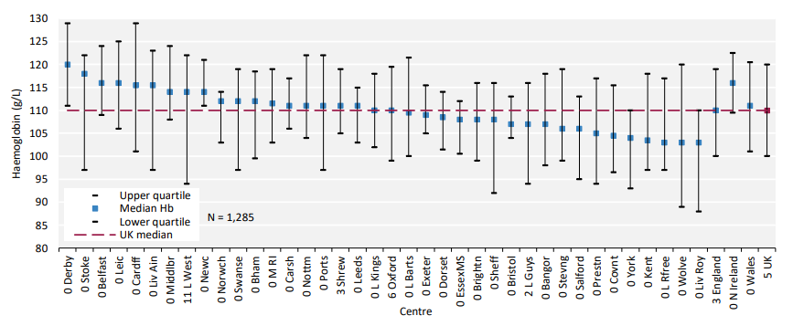
UK Renal Registry 24th Annual Report
Data to 31/12/2020
Figure 7.6 Median haemoglobin (Hb) in adult patients prevalent to HHD on 31/12/2020 by centre

Slide 7
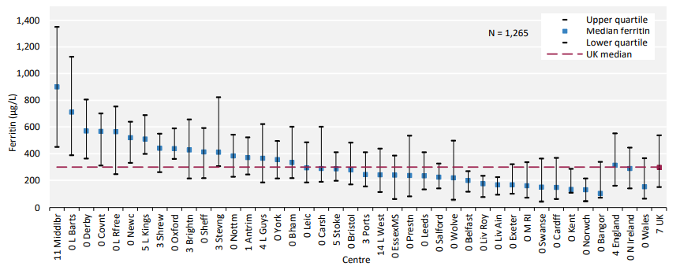
UK Renal Registry 24th Annual Report
Data to 31/12/2020
Figure 7.7 Median ferritin in adult patients prevalent to HHD on 31/12/2020 by centre

Slide 8
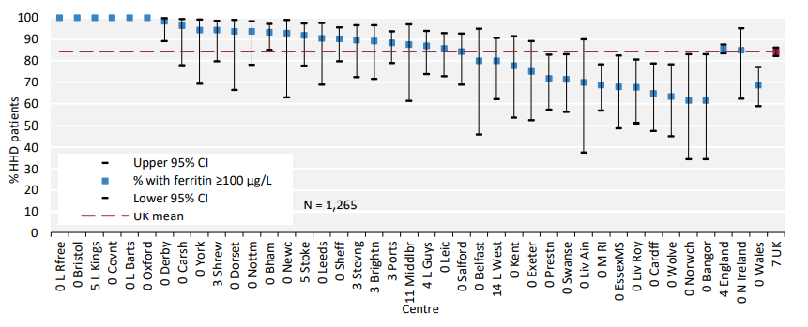
UK Renal Registry 24th Annual Report
Data to 31/12/2020
Figure 7.8 Percentage of adult patients prevalent to HHD on 31/12/2020 with ferritin ≥100 µg/L by centre
^{CI – confidence interval}

Slide 9
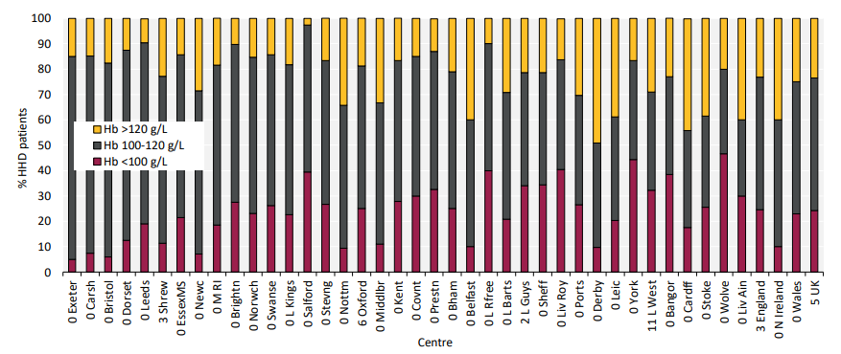
UK Renal Registry 24th Annual Report
Data to 31/12/2020
Figure 7.9 Distribution of haemoglobin (Hb) in adult patients prevalent to HHD on 31/12/2020 by centre

Slide 10
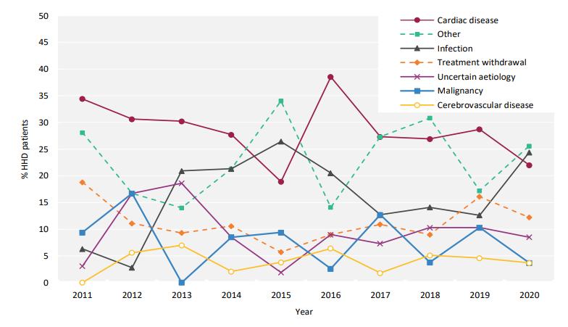
UK Renal Registry 24th Annual Report
Data to 31/12/2020
Figure 7.10 Cause of death between 2011 and 2020 for adult patients prevalent to HHD at the beginning of the year

