Slide 1
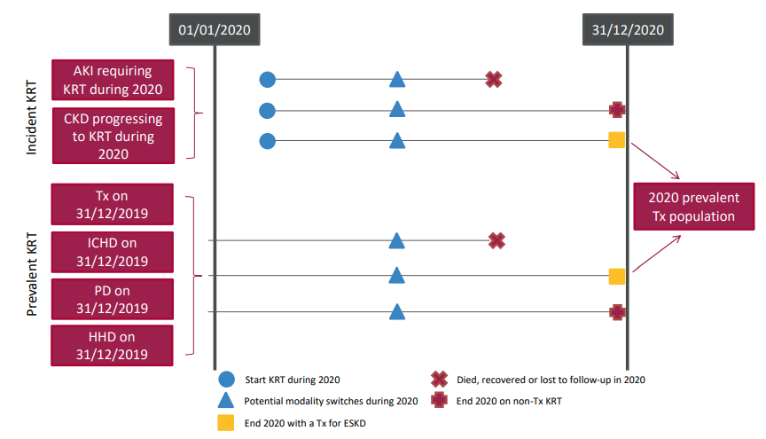
UK Renal Registry 24th Annual Report
Data to 31/12/2020
Figure 4.1 Pathways adult patients could follow to be included in the UK 2020 prevalent Tx population
Note that patients receiving dialysis for acute kidney injury (AKI) are only included in this chapter if they had a timeline or KRT modality code for Tx at the end of 2020 or if they had been on KRT for ≥90 days and were on Tx at the end of 2020.
AKI – acute kidney injury; CKD – chronic kidney disease; HHD – home haemodialysis; ICHD – in-centre haemodialysis;
PD – peritoneal dialysis; Tx - Transplantation

Slide 2
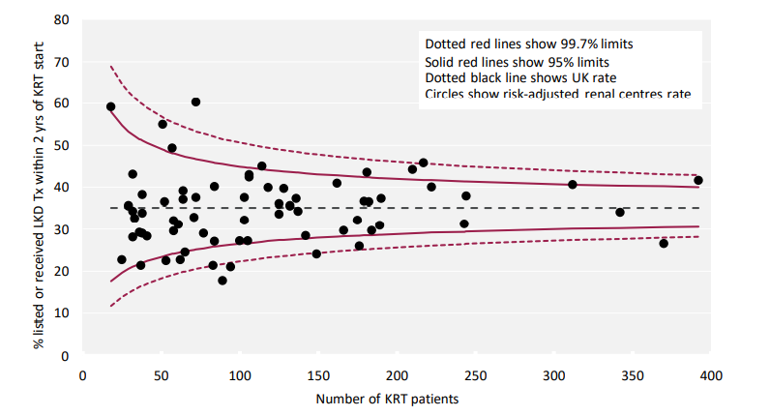
UK Renal Registry 24th Annual Report
Data to 31/12/2020
Figure 4.2 Percentage of adult patients incident to KRT in 2018 who were waitlisted or received a living kidney donor (LKD) Tx within 2 years of KRT start adjusted by age, sex and primary renal disease by centre

Slide 3
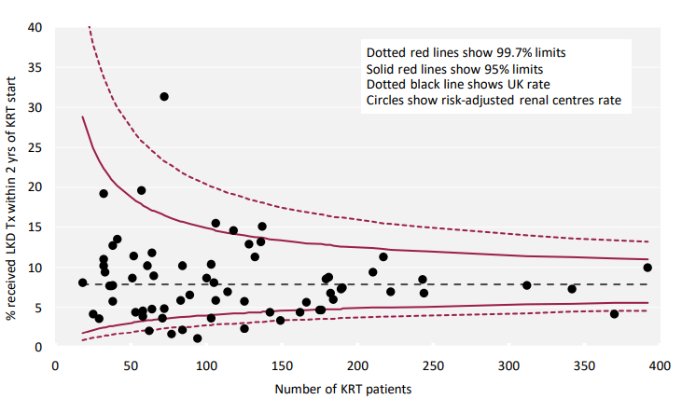
UK Renal Registry 24th Annual Report
Data to 31/12/2020
Figure 4.3 Percentage of adult patients incident to KRT in 2018 who received a living kidney donor (LKD) Tx within 2 years of KRT start adjusted by age, sex and primary renal disease by centre

Slide 4
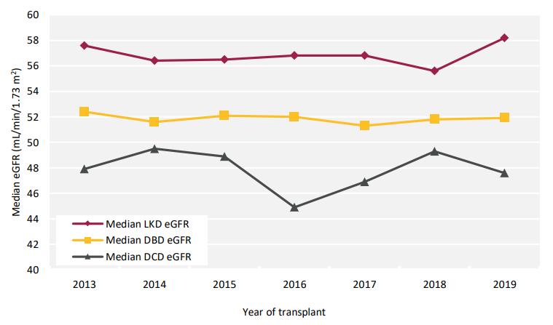
UK Renal Registry 24th Annual Report
Data to 31/12/2020
Figure 4.4 Median estimated glomerular filtration rate (eGFR) for kidney Tx at 1 year by donor type and year of transplantation between 2013 and 2019
DBD – donor after brain death; DCD – donor after circulatory death; LKD – living kidney donor

Slide 5
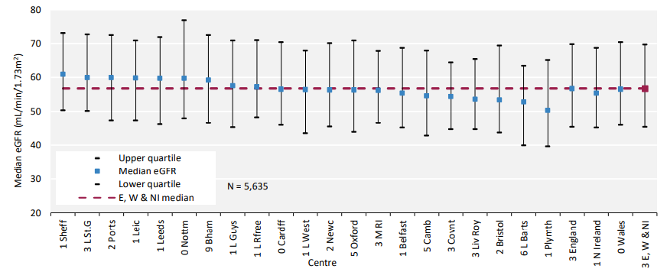
UK Renal Registry 24th Annual Report
Data to 31/12/2020
Figure 4.5 Median estimated glomerular filtration rate (eGFR) at 1 year post-living kidney donor (LKD) Tx by transplanting centre for transplantation that occurred between 2013 and 2019

Slide 6
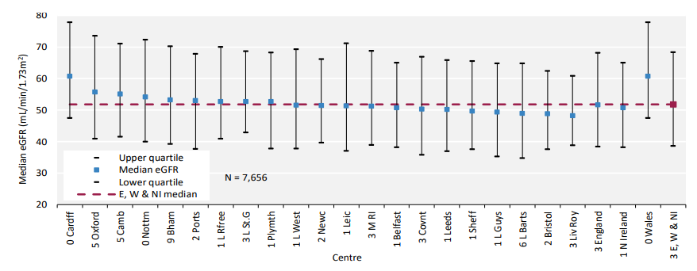
UK Renal Registry 24th Annual Report
Data to 31/12/2020
Figure 4.6 Median estimated glomerular filtration rate (eGFR) at 1 year post-donor after brain death (DBD) Tx by transplanting centre for transplantation that occurred between 2013 and 2019

Slide 7
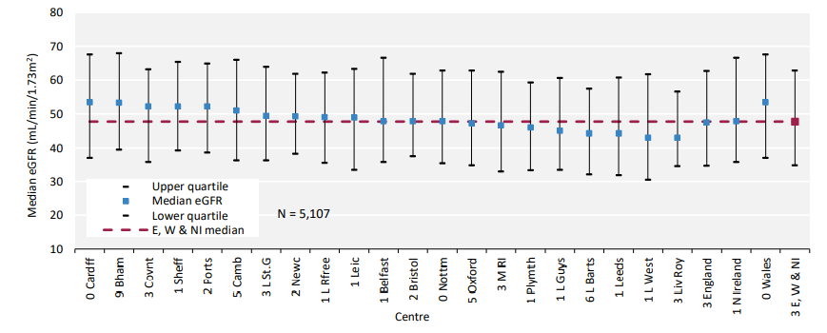
UK Renal Registry 24th Annual Report
Data to 31/12/2020
Figure 4.7 Median estimated glomerular filtration rate (eGFR) at 1 year post-donor after circulatory death (DCD) Tx by transplanting centre for transplantation that occurred between 2013 and 2019

Slide 8
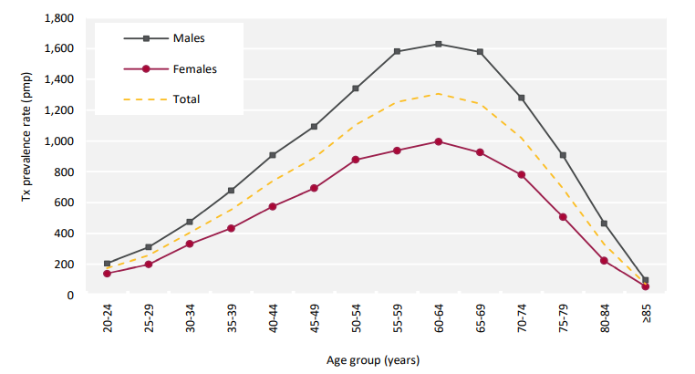
UK Renal Registry 24th Annual Report
Data to 31/12/2020
Figure 4.8 Adult Tx prevalence rate on 31/12/2020 by age group and sex
^{pmp – per million population}

Slide 9
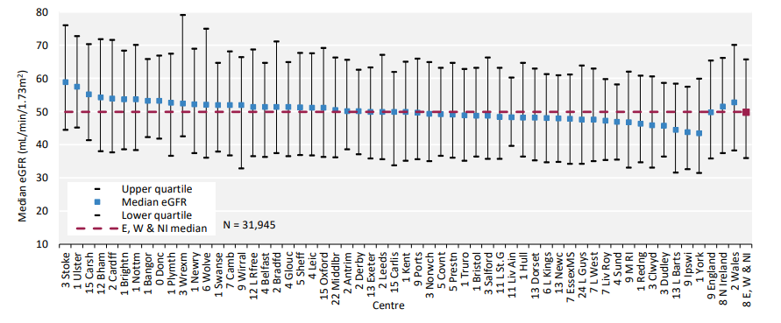
UK Renal Registry 24th Annual Report
Data to 31/12/2020
Figure 4.9 Median estimated glomerular filtration rate (eGFR) in adult patients prevalent to Tx on 31/12/2020 by centre

Slide 10
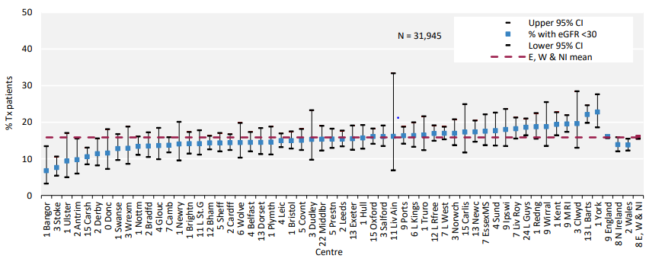
UK Renal Registry 24th Annual Report
Data to 31/12/2020
Figure 4.10 Percentage of adult patients prevalent to Tx on 31/12/2020 with an estimated glomerular filtration rate (eGFR) <30mL/min/1.73m2 by centre
^{CI – confidence interval}

Slide 11
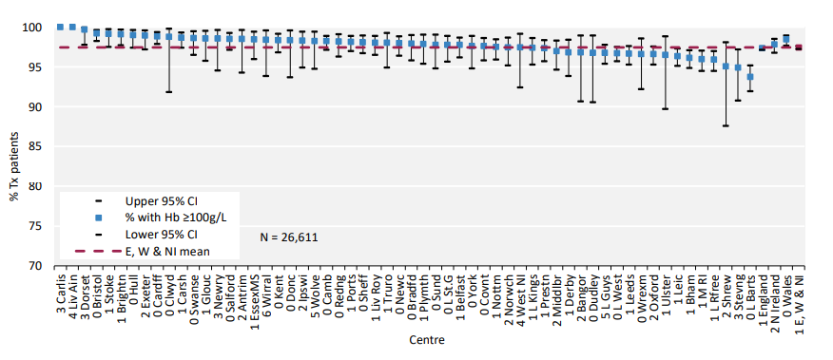
UK Renal Registry 24th Annual Report
Data to 31/12/2020
Figure 4.11 Percentage of adult patients prevalent to Tx on 31/12/2020 with an estimated glomerular filtration rate (eGFR) ≥30mL/min/1.73m2 achieving haemoglobin (Hb) ≥100g/L by centre
^{CI – confidence interval}

Slide 12
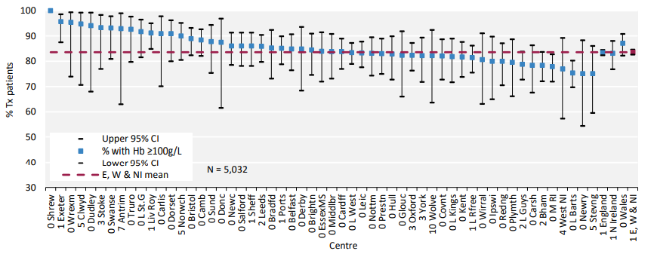
UK Renal Registry 24th Annual Report
Data to 31/12/2020
Figure 4.12 Percentage of adult patients prevalent to Tx on 31/12/2020 with an estimated glomerular filtration rate (eGFR) <30mL/min/1.73m2 achieving haemoglobin (Hb) ≥100g/L by centre
^{CI – confidence interval}

Slide 13
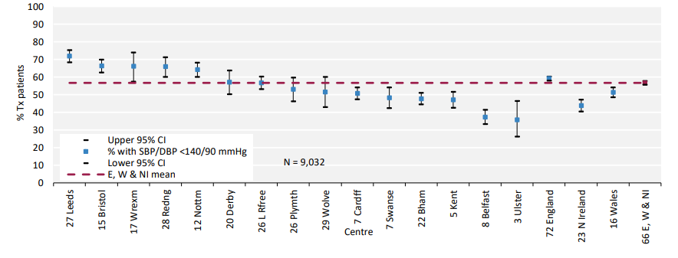
UK Renal Registry 24th Annual Report
Data to 31/12/2020
Figure 4.13 Percentage of adult patients prevalent to Tx on 31/12/2020 with estimated glomerular filtration rate (eGFR) ≥30 mL/min/1.73m2 achieving blood pressure of <140/90 mmHg by centre
CI – confidence interval; DBP – diastolic blood pressure; SBP – systolic blood pressure

Slide 14
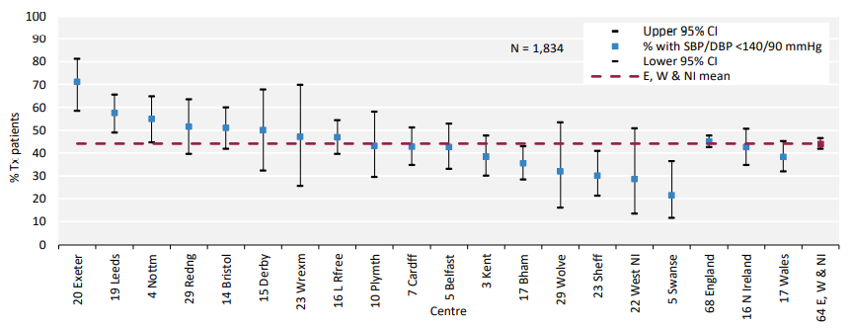
UK Renal Registry 24th Annual Report
Data to 31/12/2020
Figure 4.14 Percentage of adult patients prevalent to Tx on 31/12/2020 with estimated glomerular filtration rate (eGFR) <30 mL/min/1.73m2 achieving blood pressure of <140/90 mmHg by centre
CI – confidence interval; DBP – diastolic blood pressure; SBP – systolic blood pressure

Slide 15
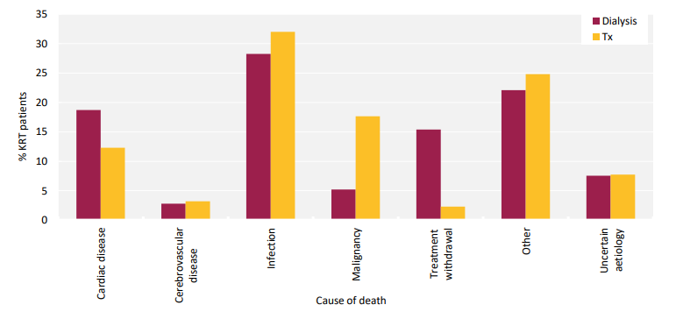
UK Renal Registry 24th Annual Report
Data to 31/12/2020
Figure 4.15 Cause of death for adult patients prevalent to KRT on 31/12/2019 followed-up in 2020 by modality

Slide 16
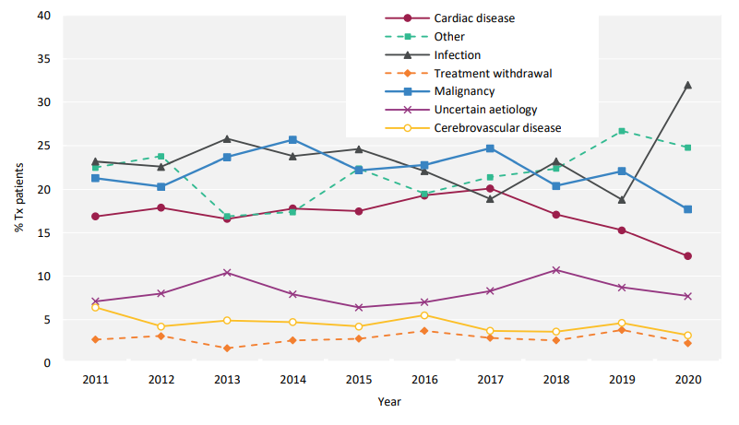
UK Renal Registry 24th Annual Report
Data to 31/12/2020
Figure 4.16 Cause of death between for adult patients prevalent to transplant by year.

