Slide 1
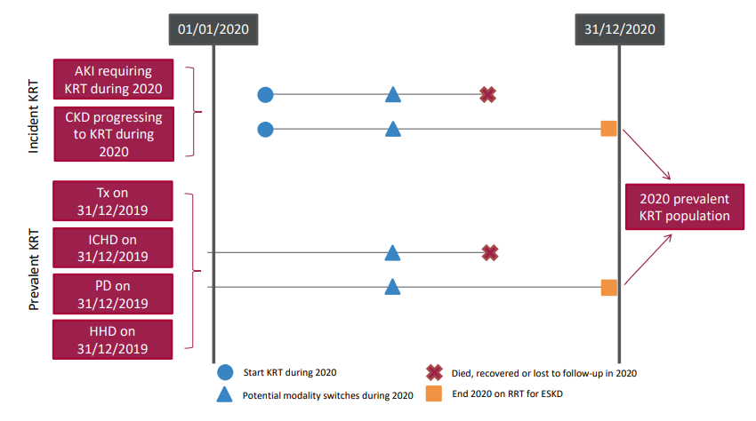
UK Renal Registry 24th Annual Report
Data to 31/12/2020
Figure 3.1 Pathways adult patients could follow to be included in the UK 2020 prevalent KRT population
Note that patients receiving dialysis for acute kidney injury (AKI) are only included in this chapter if they had a timeline or KRT modality code for chronic KRT at the end of 2020 or if they had been on KRT for ≥90 days and were on KRT at the end of 2020.
CKD – chronic kidney disease; Tx – transplant

Slide 2
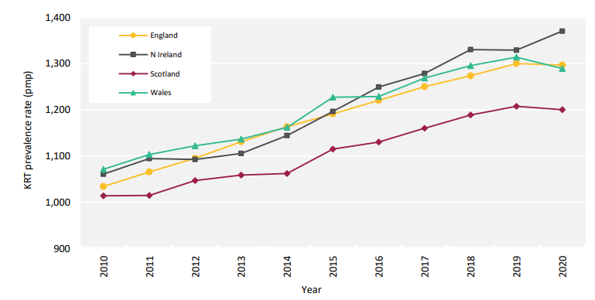
UK Renal Registry 24th Annual Report
Data to 31/12/2020
Figure 3.2 Adult KRT prevalence rates by country between 2010 and 2020
^{pmp – per million population}

Slide 3
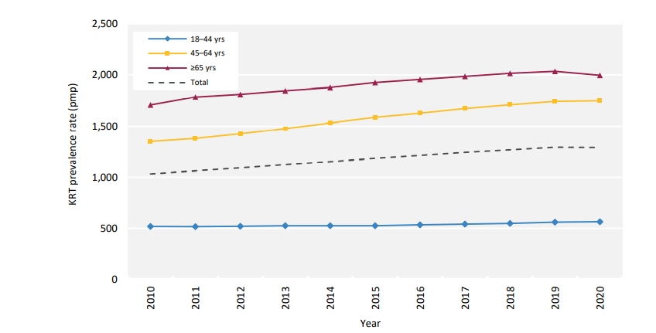
UK Renal Registry 24th Annual Report
Data to 31/12/2020
Figure 3.3 Adult KRT prevalence rates by age group between 2010 and 2020
^{pmp – per million population}

Slide 4
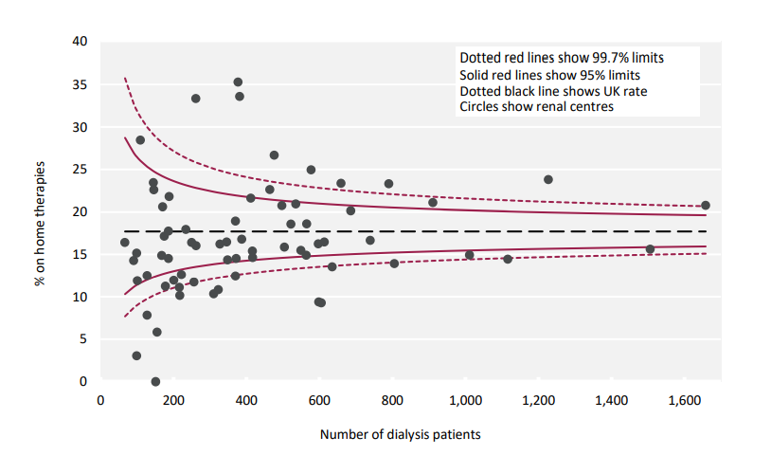
UK Renal Registry 24th Annual Report
Data to 31/12/2020
Figure 3.4 Percentage of adult patients prevalent to dialysis on 31/12/2020 on home therapies (PD and HHD) by centre

Slide 5
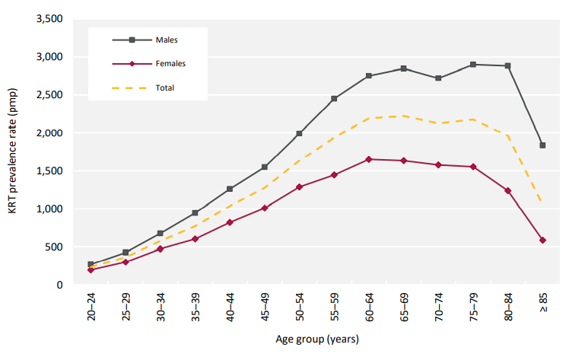
UK Renal Registry 24th Annual Report
Data to 31/12/2020
Figure 3.5 Prevalence rates for adult patients on KRT on 31/12/2020 by age group and sex

Slide 6
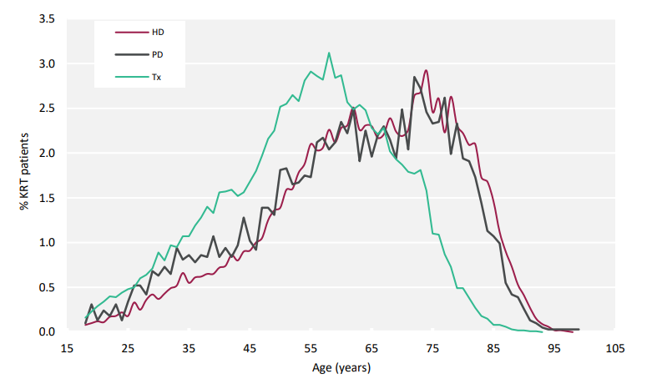
UK Renal Registry 24th Annual Report
Data to 31/12/2020
Figure 3.6 Age profile of adult patients prevalent to KRT on 31/12/2020 by KRT modality

Slide 7
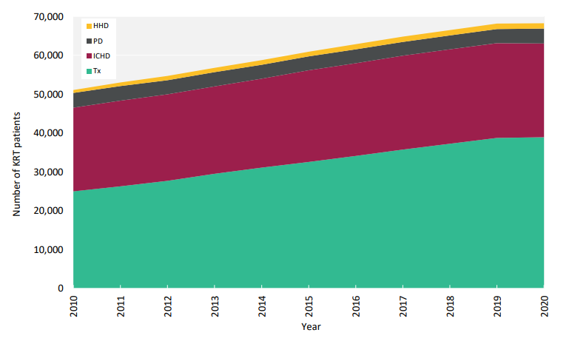
UK Renal Registry 24th Annual Report
Data to 31/12/2020
Figure 3.7 Growth in numbers of prevalent adult KRT patients by treatment modality between 2010 and 2020

Slide 8
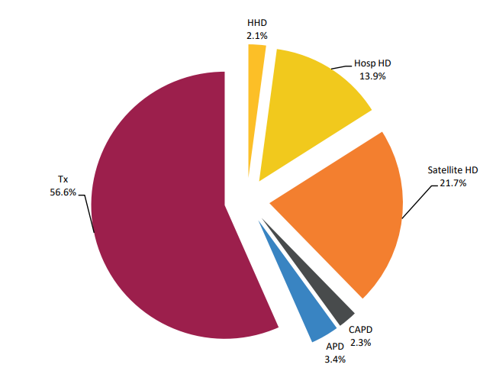
UK Renal Registry 24th Annual Report
Data to 31/12/2020
Figure 3.8 Detailed treatment modality of adult patients prevalent to KRT on 31/12/2020
No Scottish centres were included because data on satellite HD were not available.
APD – automated PD; CAPD – continuous ambulatory PD.

Slide 9
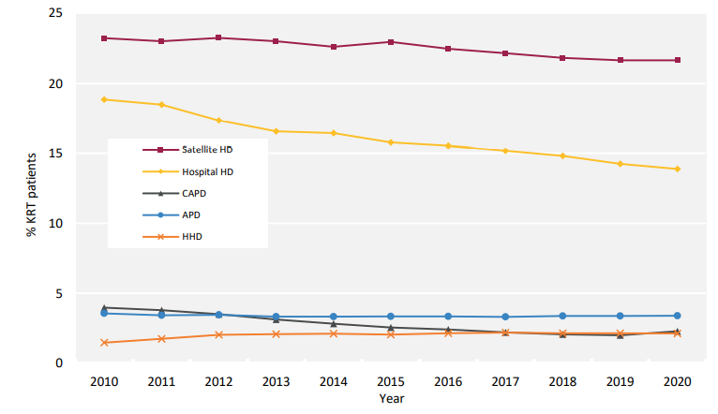
UK Renal Registry 24th Annual Report
Data to 31/12/2020
Figure 3.9 Detailed dialysis modality changes in prevalent adult KRT patients between 2010 and 2020
No Scottish centres were included because data on satellite HD were not available.
The denominator includes patients with a Tx.
APD – automated PD; CAPD – continuous ambulatory PD.

Slide 10
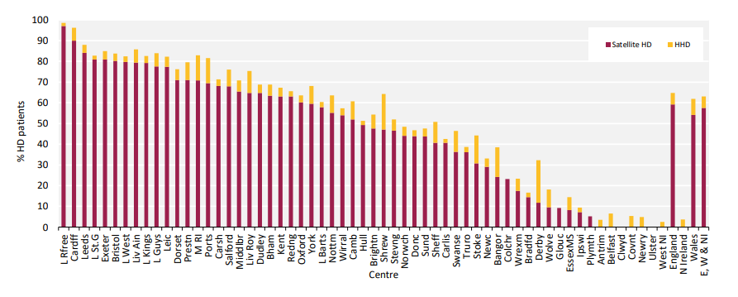
UK Renal Registry 24th Annual Report
Data to 31/12/2020
Figure 3.10 Adult patients prevalent to HD on 31/12/2020 treated with satellite HD or HHD by centre
There were no satellite units in Northern Ireland and Scottish centres were excluded because data on satellite HD were not available.

Slide 11
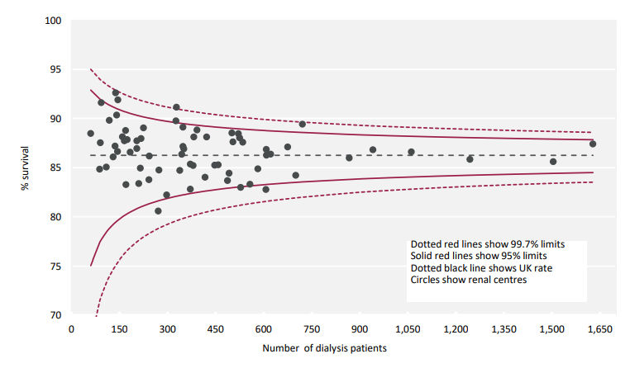
UK Renal Registry 24th Annual Report
Data to 31/12/2020
Figure 3.11 1 year survival (adjusted to age 60 years) of adult patients prevalent to dialysis on 31/12/2019 by centre

Slide 12
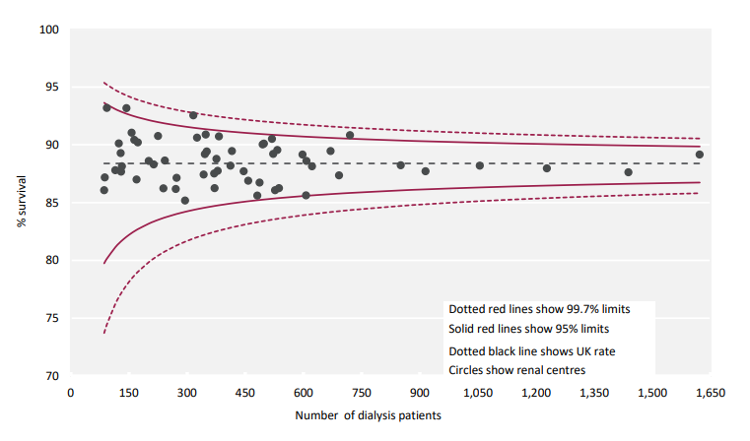
UK Renal Registry 24th Annual Report
Data to 31/12/2020
Figure 3.12 1 year survival (adjusted to 60 years, male and median comorbidity score) of adult patients prevalent to dialysis on 31/12/2019 by centre

Slide 13
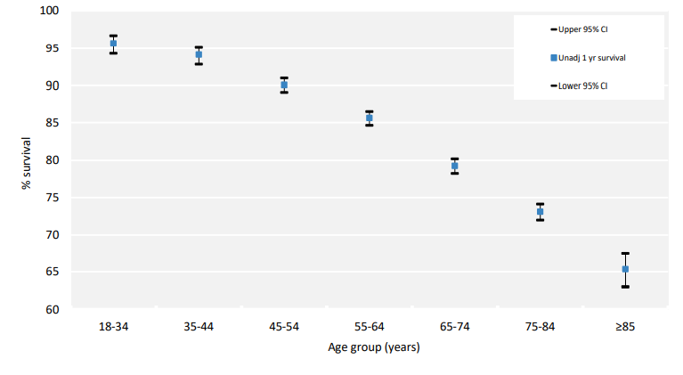
UK Renal Registry 24th Annual Report
Data to 31/12/2020
Figure 3.13 1 year survival (unadjusted) of adult patients prevalent to dialysis on 31/12/2019 by age group
^{CI – confidence interval}

Slide 14
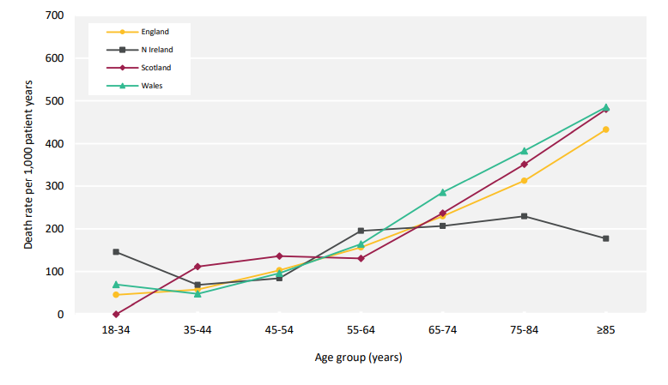
UK Renal Registry 24th Annual Report
Data to 31/12/2020
Figure 3.14 1 year death rate per 1,000 patient years for adult patients prevalent to dialysis on 31/12/2019 by country and age group

Slide 15
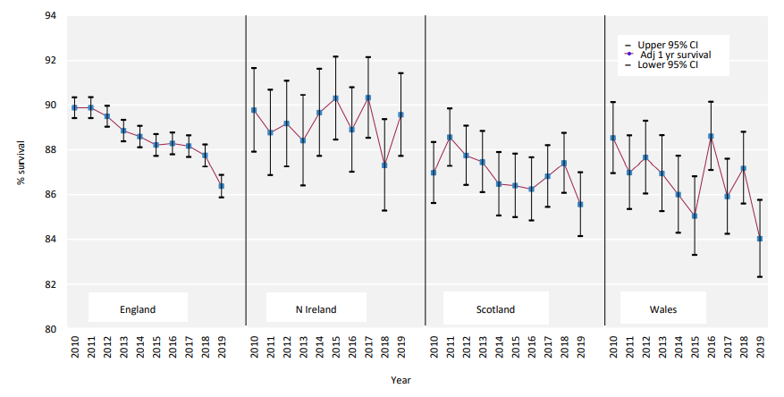
UK Renal Registry 24th Annual Report
Data to 31/12/2020
Figure 3.15 1 year survival (adjusted to age 60 years) for prevalent adult dialysis patients by country between 2010 and 2019
^{CI – confidence interval}

Slide 16
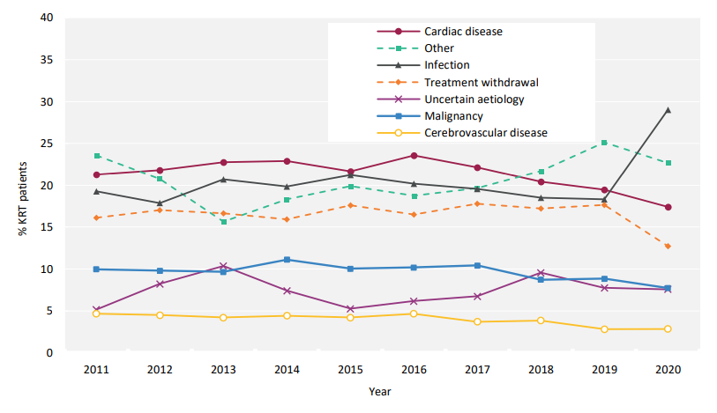
UK Renal Registry 24th Annual Report
Data to 31/12/2020
Figure 3.16 Cause of death between 2011 and 2020 for adult patients prevalent to KRT at the beginning of the year

