Slide 1
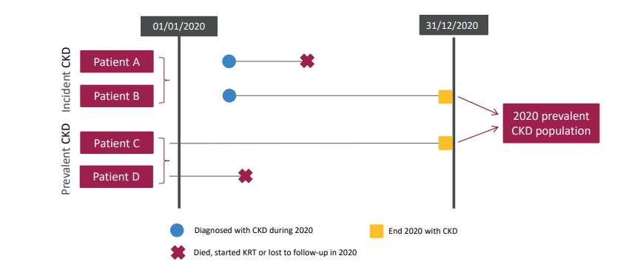
UK Renal Registry 24th Annual Report
Data to 31/12/2020
Figure 1.1 Pathways adult patients could follow to be included in the UK 2020 prevalent CKD population

Slide 2
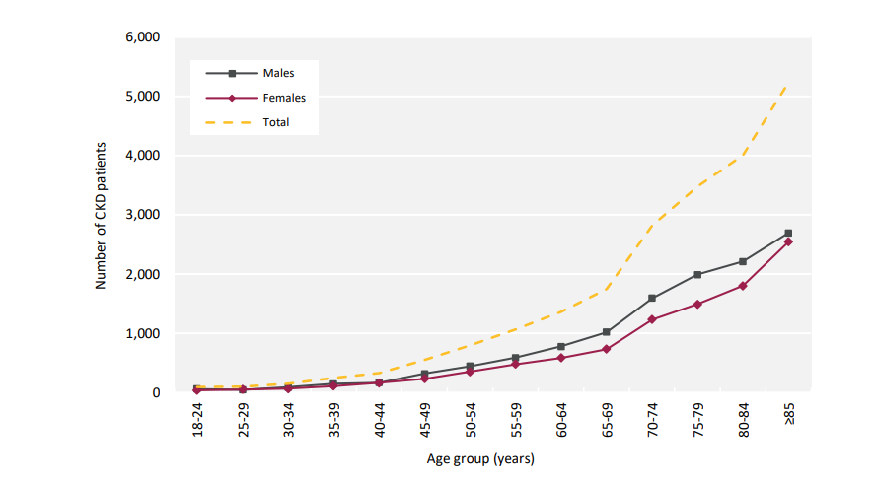
UK Renal Registry 24th Annual Report
Data to 31/12/2020
Figure 1.2 Number of adult patients prevalent to CKD stages G4 and 5 on 31/12/2020 by age group and sex

Slide 3
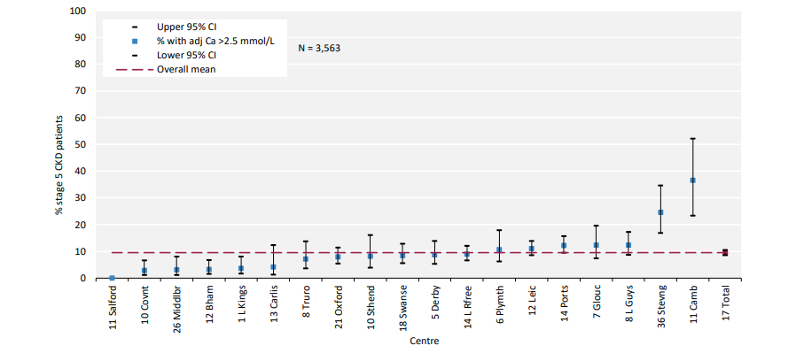
UK Renal Registry 24th Annual Report
Data to 31/12/2020
Percentage of adult patients prevalent to CKD stage G5 on 31/12/2020 with adjusted serum calcium (Ca) ^{>2.5 mmol/L by centre}

Slide 4
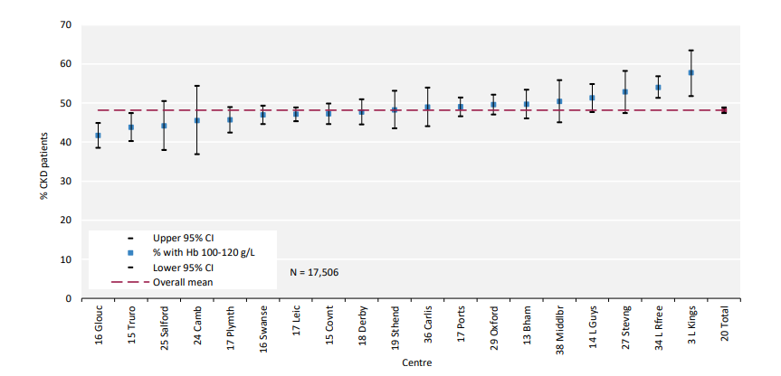
UK Renal Registry 24th Annual Report
Data to 31/12/2020
Figure 1.4 Percentage of adult patients prevalent to CKD stages G4 and 5 on 31/12/2020 with haemoglobin (Hb) ^{100–120 g/L by centre}

Slide 5
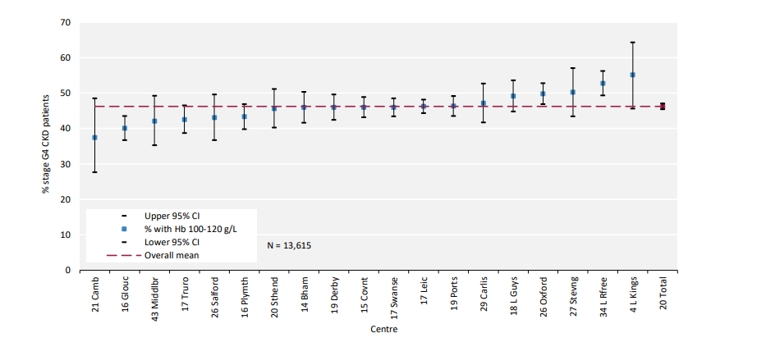
UK Renal Registry 24th Annual Report
Data to 31/12/2020
Figure 1.5 Percentage of adult patients prevalent to CKD stage G4 on 31/12/2020 with haemoglobin (Hb) 100–120 g/L by centre

Slide 6
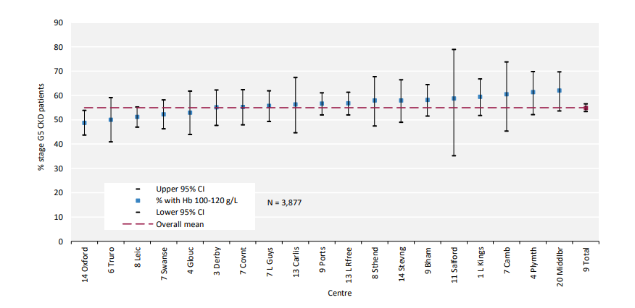
UK Renal Registry 24th Annual Report
Data to 31/12/2020
Figure 1.6 Percentage of adult patients prevalent to CKD stage G5 on 31/12/2020 with haemoglobin (Hb) 100-120 g/L by centre

