Slide 1
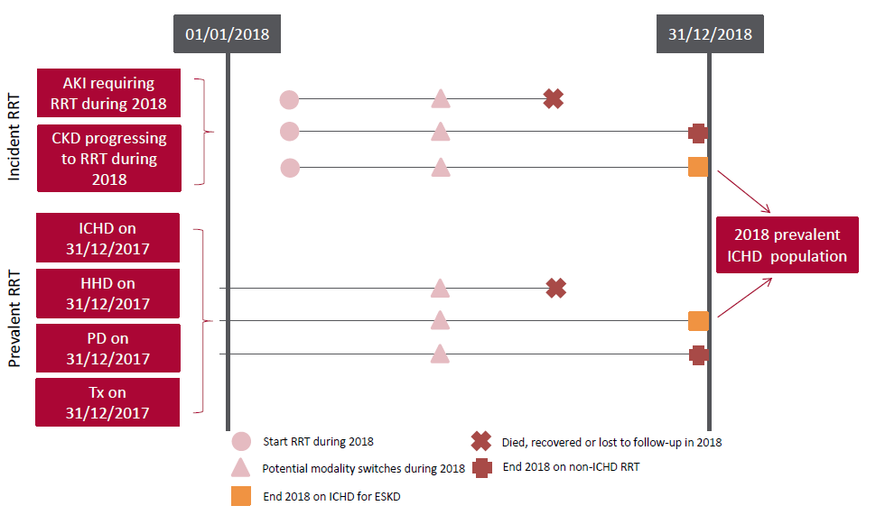
UK Renal Registry 22nd Annual Report
Data to 31/12/2018
Figure 4.1 Pathways adult patients could follow to be included in the UK 2018 prevalent ICHD population
Note that patients receiving dialysis for acute kidney injury (AKI) are only included in this chapter if they had a timeline or RRT modality code for chronic
ICHD at the end of 2018 or if they had been on RRT for ≥90 days and were on ICHD at the end of 2018.
CKD – chronic kidney disease

Slide 2
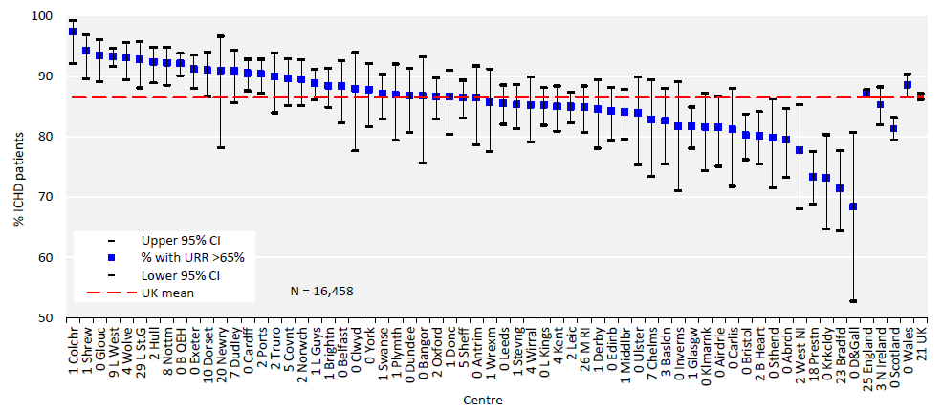
UK Renal Registry 22nd Annual Report
Data to 31/12/2018
Figure 4.2 Percentage of adult patients prevalent to ICHD on 31/12/2018 with urea reduction ratio (URR) >65% by centre
CI – confidence interval

Slide 3
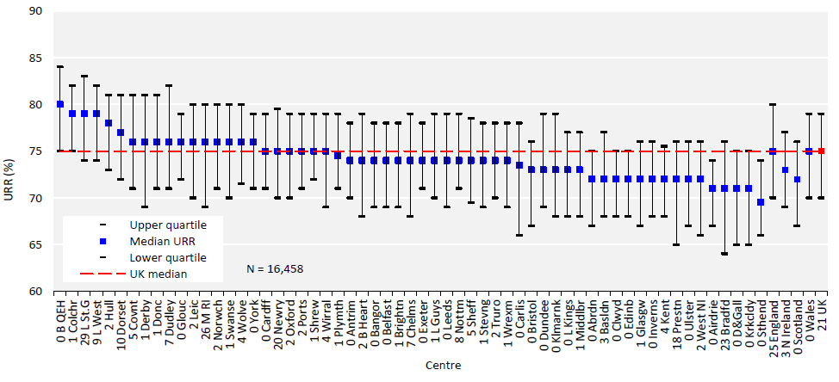
UK Renal Registry 22nd Annual Report
Data to 31/12/2018
Figure 4.3 Median urea reduction ratio (URR) achieved in adult patients prevalent to ICHD on 31/12/2018 by centre

Slide 4
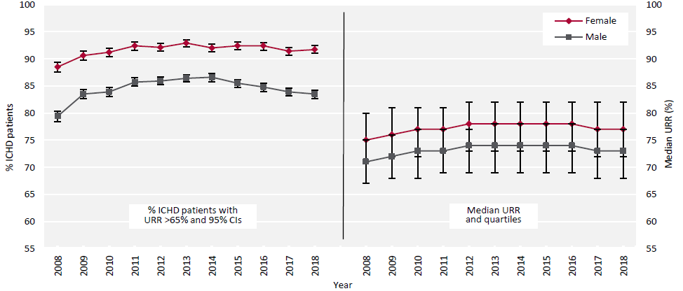
UK Renal Registry 22nd Annual Report
Data to 31/12/2018
Figure 4.4 Change in the percentage of prevalent adult ICHD patients with urea reduction ratio (URR) >65% and the median
URR by sex between 2008 and 2018
CI – confidence interval

Slide 5
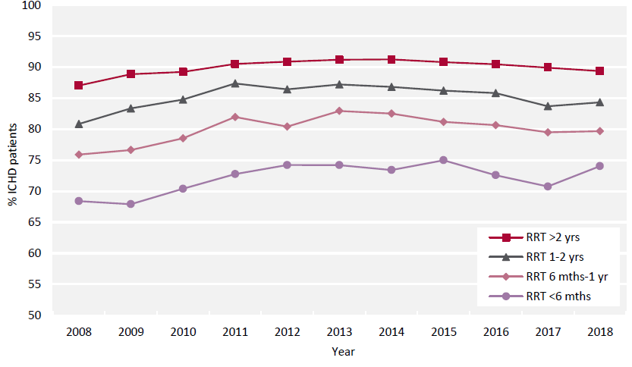
UK Renal Registry 22nd Annual Report
Data to 31/12/2018
Figure 4.5 Percentage of prevalent adult ICHD patients achieving urea reduction ratio (URR) >65% by time on RRT
between 2008 and 2018

Slide 6
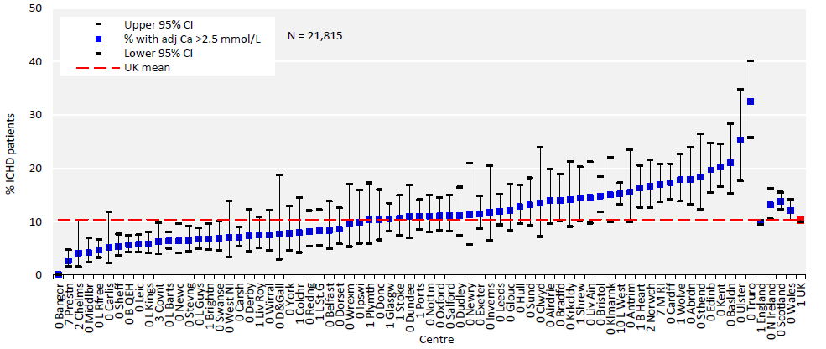
UK Renal Registry 22nd Annual Report
Data to 31/12/2018
Figure 4.6 Percentage of adult patients prevalent to ICHD on 31/12/2018 with adjusted calcium (Ca) above the target range
(>2.5 mmol/L) by centre
CI – confidence interval

Slide 7
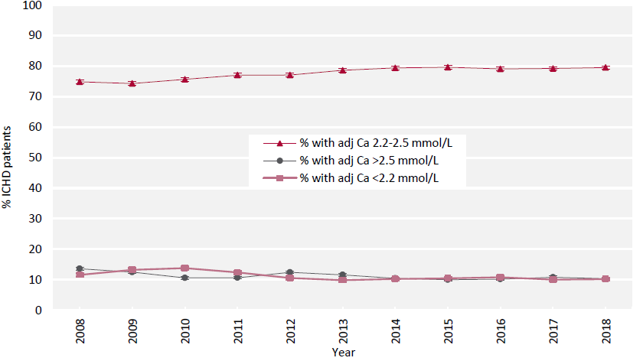
UK Renal Registry 22nd Annual Report
Data to 31/12/2018
Figure 4.7 Change in percentage of prevalent adult ICHD patients within, above and below the target range for adjusted
calcium (Ca 2.2–2.5 mmol/L) between 2008 and 2018

Slide 8
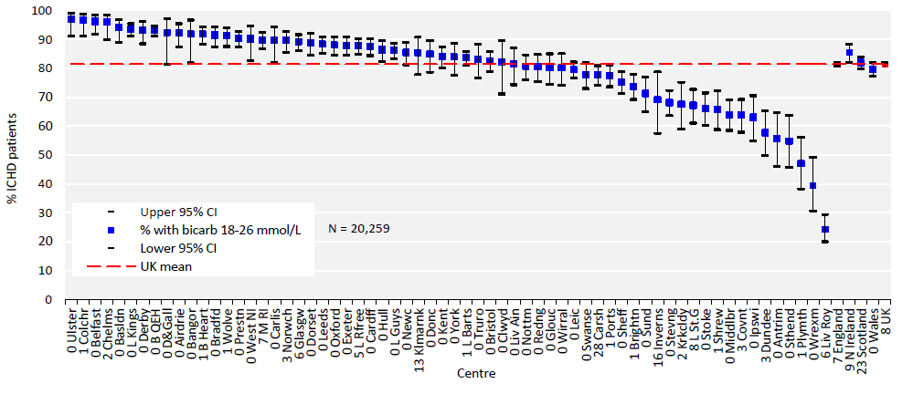
UK Renal Registry 22nd Annual Report
Data to 31/12/2018
Figure 4.8 Percentage of adult patients prevalent to ICHD on 31/12/2018 with pre-dialysis bicarbonate (bicarb) within the
target range (18–26 mmol/L) by centre
CI – confidence interval

Slide 9
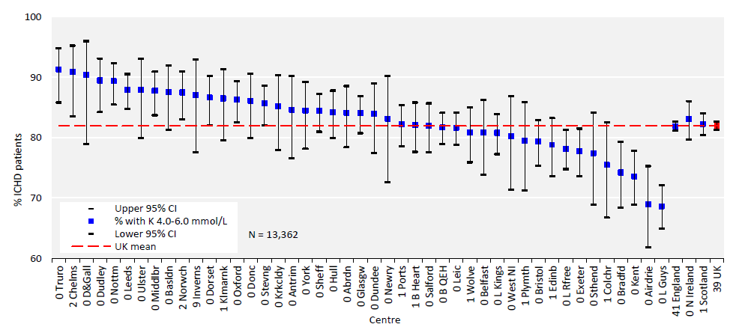
UK Renal Registry 22nd Annual Report
Data to 31/12/2018
Figure 4.9 Percentage of adult patients prevalent to ICHD on 31/12/2018 with pre-dialysis potassium (K) within the target
range (4.0–6.0 mmol/L) by centre
CI – confidence interval

Slide 10
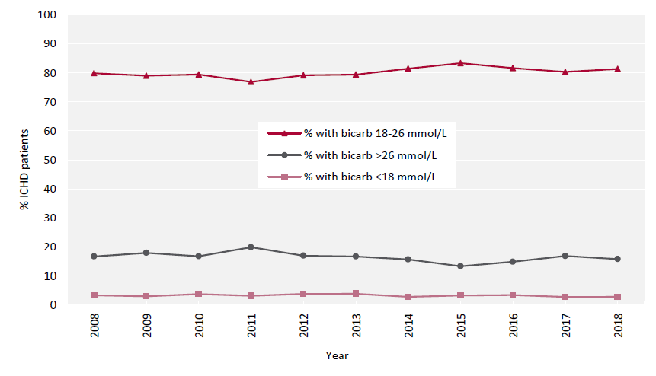
UK Renal Registry 22nd Annual Report
Data to 31/12/2018
Figure 4.10 Change in percentage of prevalent adult ICHD patients within, above and below the target range for pre-dialysis
bicarbonate (bicarb 18–26 mmol/L) between 2008 and 2018

Slide 11
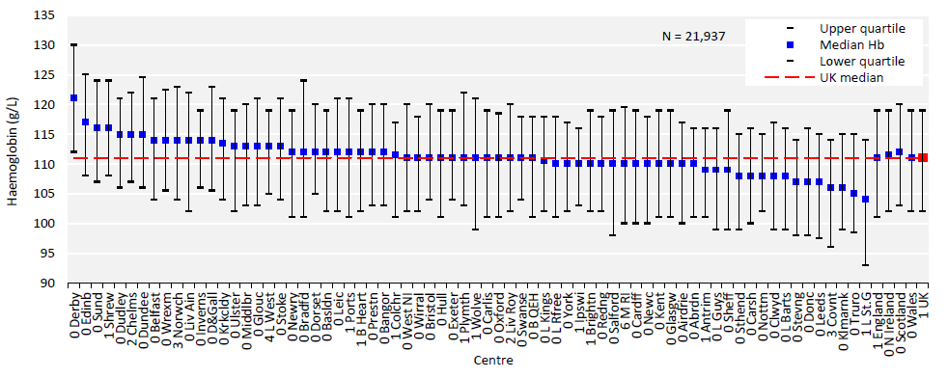
UK Renal Registry 22nd Annual Report
Data to 31/12/2018
Figure 4.11 Median haemoglobin (Hb) in adult patients prevalent to ICHD on 31/12/2018 by centre

Slide 12
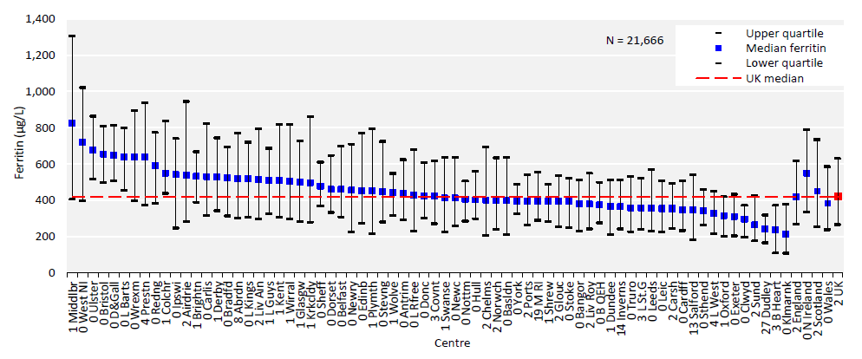
UK Renal Registry 22nd Annual Report
Data to 31/12/2018
Figure 4.12 Median ferritin in adult patients prevalent to ICHD on 31/12/2018 by centre

Slide 13
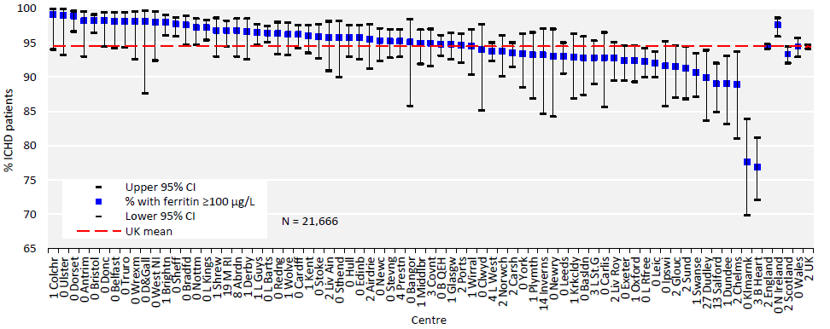
UK Renal Registry 22nd Annual Report
Data to 31/12/2018
Figure 4.13 Percentage of adult patients prevalent to ICHD on 31/12/2018 with ferritin ≥100 μg/L by centre
CI – confidence interval

Slide 14
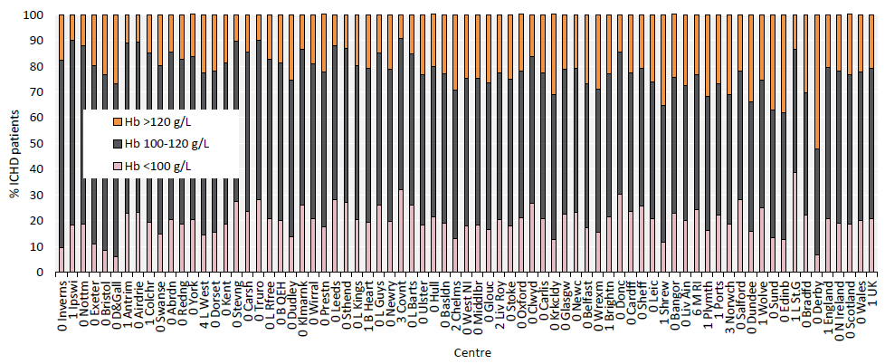
UK Renal Registry 22nd Annual Report
Data to 31/12/2018
Figure 4.14 Distribution of haemoglobin (Hb) in adult patients prevalent to ICHD on 31/12/2018 by centre

Slide 15
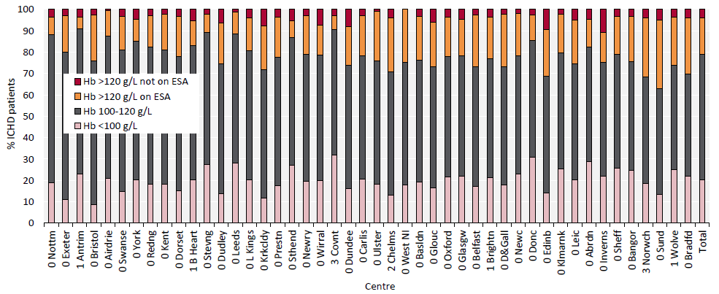
UK Renal Registry 22nd Annual Report
Data to 31/12/2018
Figure 4.15 Distribution of haemoglobin (Hb) in adult patients prevalent to ICHD on 31/12/2018 and the proportion with
haemoglobin >120 g/L receiving erythropoiesis stimulating agent (ESA) by centre
Figure (including total) does not include centres with <70% data completeness (or <70% ESA use).
Data for Scotland refer to patients prevalent to ICHD on 31/5/2018 due to ESA data availability.

Slide 16
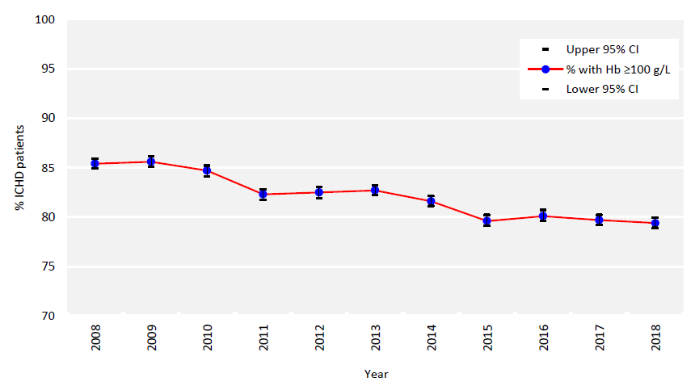
UK Renal Registry 22nd Annual Report
Data to 31/12/2018
Figure 4.16 Percentage of prevalent adult ICHD patients with haemoglobin (Hb) ≥100 g/L between 2008 and 2018
CI – confidence interval

Slide 17
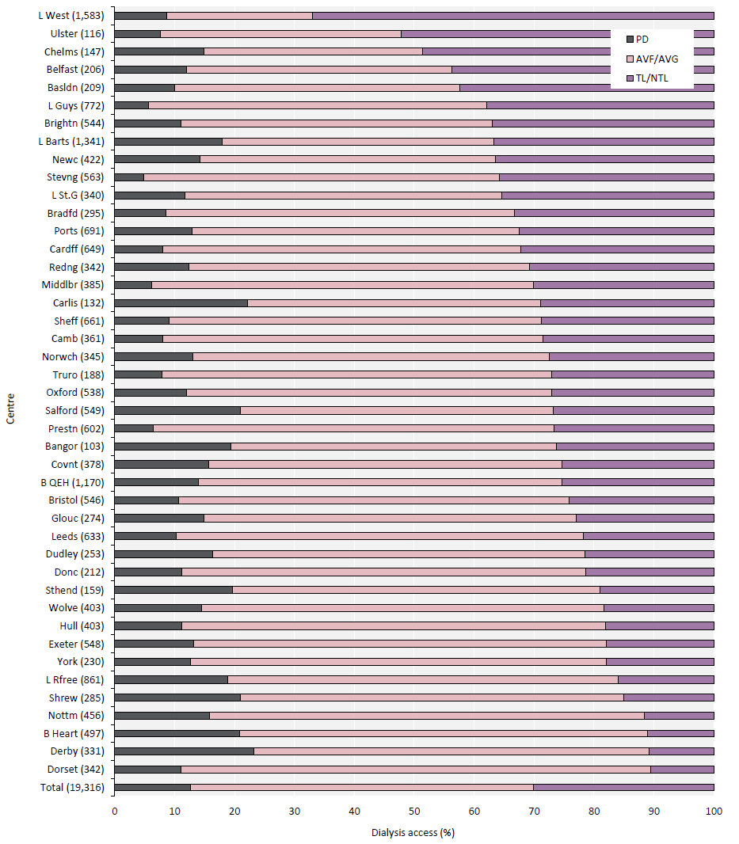
UK Renal Registry 22nd Annual Report
Data to 31/12/2018
Figure 4.17 Dialysis access in adult patients prevalent to dialysis on 31/12/2018 by centre (2018 Multisite Dialysis Access Audit)
Number of patients on dialysis in a centre in brackets (centres with <70% access data for the prevalent dialysis population were excluded).
AVF – arteriovenous fistula; AVG – arteriovenous graft; NTL – non-tunnelled line; TL – tunnelled line

Slide 18
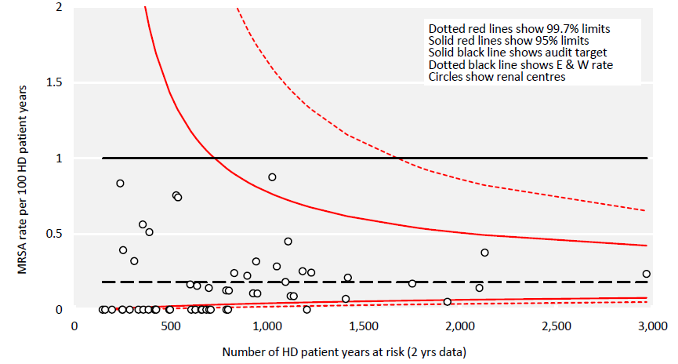
UK Renal Registry 22nd Annual Report
Data to 31/12/2018
Figure 4.18 Methicillin-resistant Staphylococcus aureus (MRSA) rates by centre per 100 HD adult patient years
(2017–2018 data) compared to audit target

Slide 19
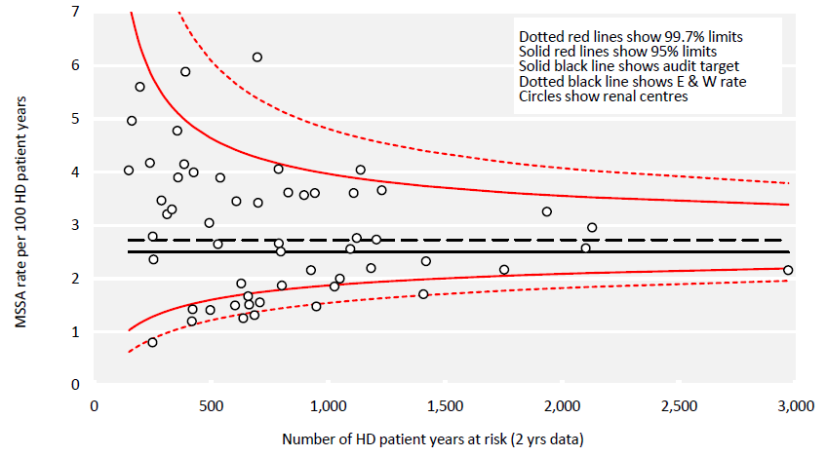
UK Renal Registry 22nd Annual Report
Data to 31/12/2018
Figure 4.19 Methicillin-sensitive Staphylococcus aureus (MSSA) rates by centre per 100 HD adult patient years (2017–2018 data)
compared to audit target

Slide 20
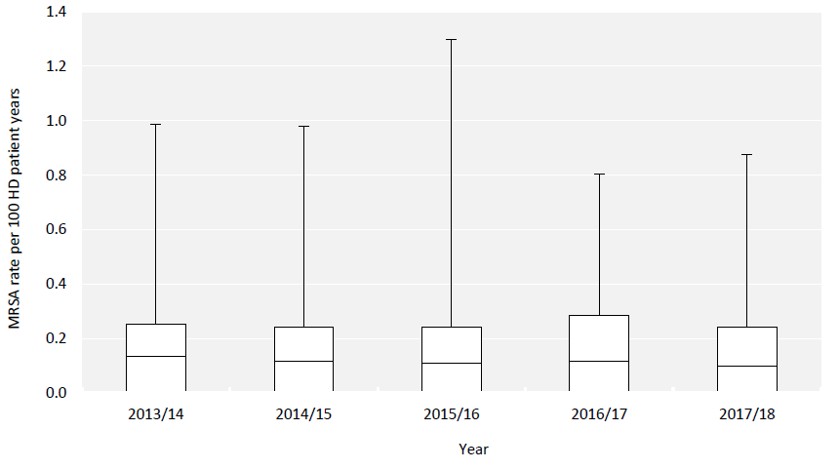
UK Renal Registry 22nd Annual Report
Data to 31/12/2018
Figure 4.20 Distribution of methicillin-resistant Staphylococcus aureus (MRSA) centre rates per 100 HD adult patient years by
rolling 2 calendar year cohort (Wales included from 2016 onwards)

Slide 21
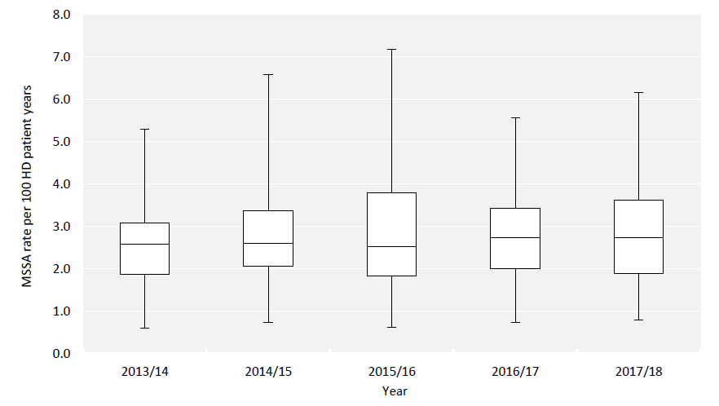
UK Renal Registry 22nd Annual Report
Data to 31/12/2018
Figure 4.21 Distribution of methicillin-sensitive Staphylococcus aureus (MSSA) centre rates per 100 HD adult patient years by
rolling 2 calendar year cohort (Wales included from 2016 onwards)

Slide 22
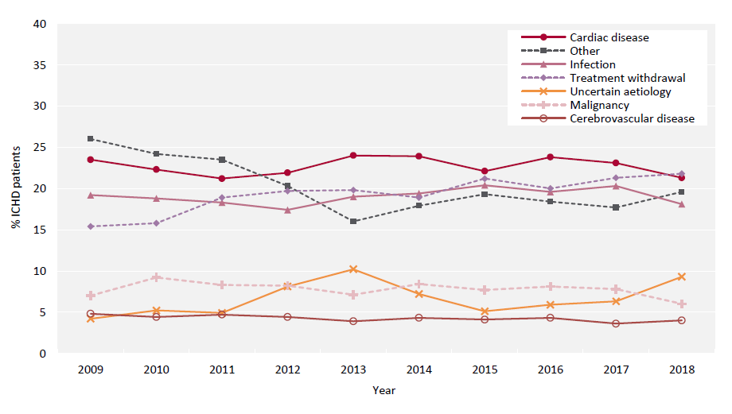
UK Renal Registry 22nd Annual Report
Data to 31/12/2018
Figure 4.22 Cause of death between 2009 and 2018 for adult patients prevalent to ICHD at the beginning of the year

